Slide 1

How to do the first patient consultation?
Version February 2025

Slide 2
Note
This presentation will be a practical guide on how to conduct your first case nurse consultation using the Tool Suite (V2)
  It will not include all technical details on how to use the CoroPrevention Tool Suite, but it will guide you through some examples
This presentation does not include:
  Completing the EDC system
  Completing the questionnaires in the ePRO application (on the tablet)

Slide 3

Patient description – Miss Carolyn Prevett
67-year old female
History
  NSTEMI
  For which PCI was performed on 19/01/2022
Risk factors:
  LDL 67 mg/dL (1.7 mmol/L)
  Average BP 148/67 mm Hg
  Smoker
  Low physical activity (average 4500 steps / day, 6MWT 378m)
  Current medication: bisoprolol 5 mg/d, atorvastatin 40 mg/d
  No second vascular event in the last two years
  Low medication adherence
  Has a healthy diet based on the Mediterranean diet
  Higher stress levels since the cardiac event
HbA1c 5,7% (no diabetes)

Slide 4
An example of “Visit 2”

Slide 5
The patient comes into the consultation room
Let patient sit down, ask if everything went well with completing the questionnaires
If the patient was not able to complete all questionnaires, complete the questionnaires together on the tablet.

Slide 6
Explain today’s visit
Ask what the patient recalls about the aim and procedure of the intervention. Follow up with:
“Would you like me to tell a bit more into detail about ...?”
Correct or confirm
“This intervention is intended to support you in making healthier lifestyle choices to the extent that you wish to do so.”
Determine the agenda for today in consent with the patient
“If that is okay for you, today we can take a look together at how you are doing regarding those health behaviours that are related to your heart. And maybe also talk about possible changes you would like to make that we can support you in.”

Slide 7
Now open the caregiver dashboard.
Go to the caregiver dashboard page, and look up the patient’s record using the subject ID.
Then it is time for the following steps: Opening the patient record, inserting vital signs, 6MWT results, clinical assessment and medication DSS related information

Slide 8
https://dashboard-dev.coroprevention.eu/

Slide 9
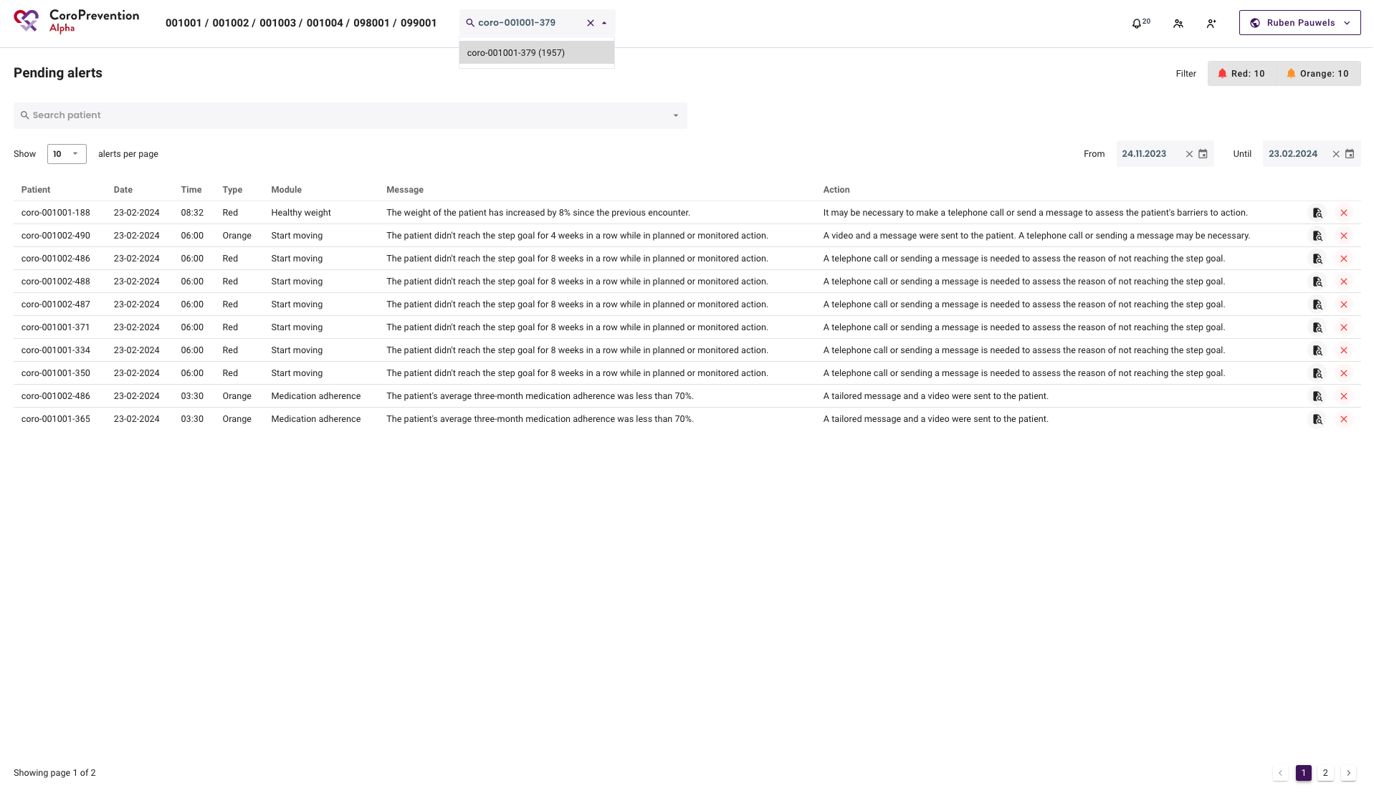

Slide 10
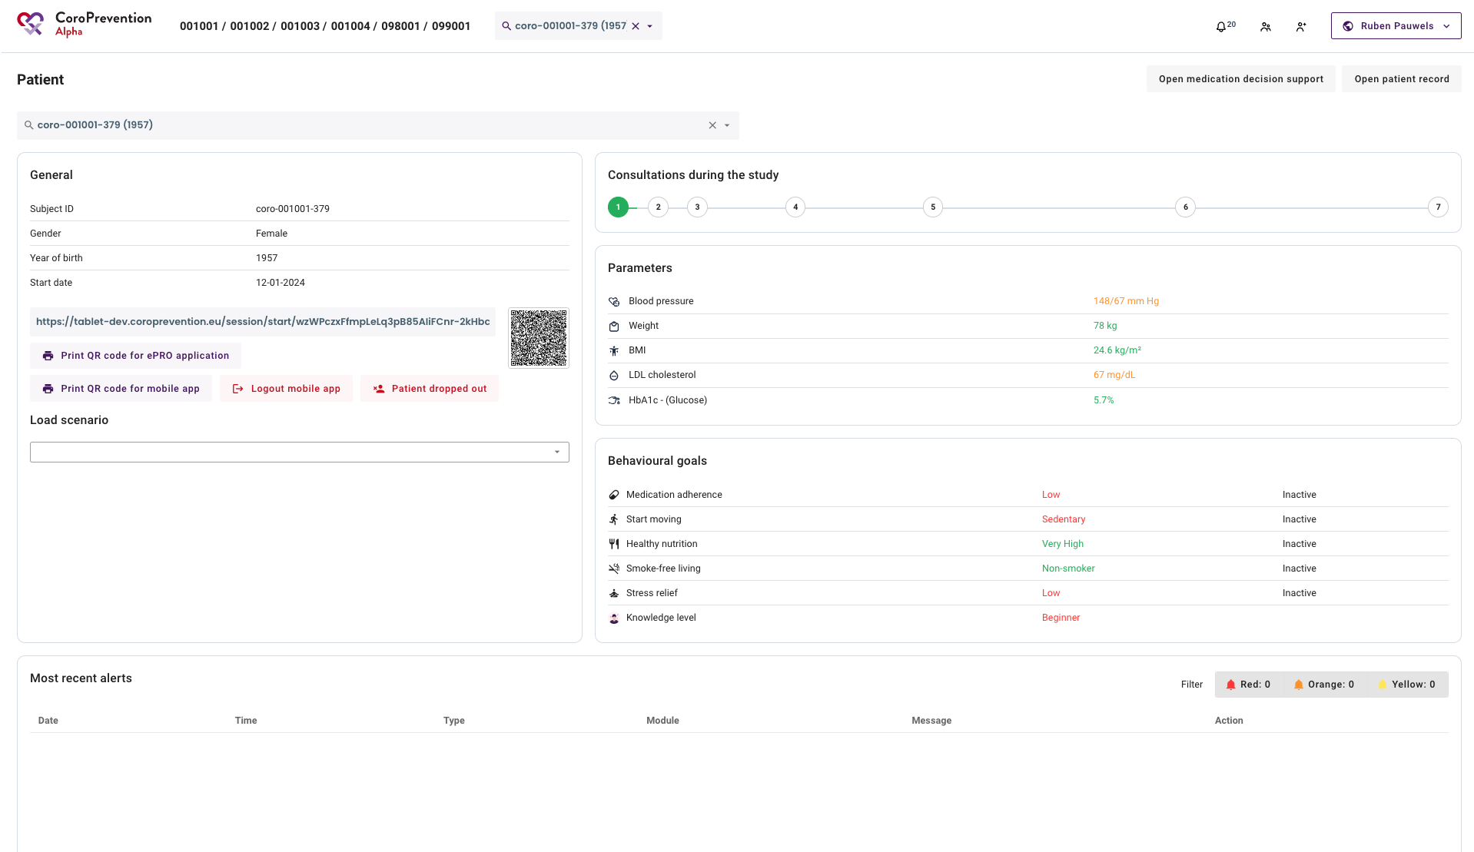

Slide 11
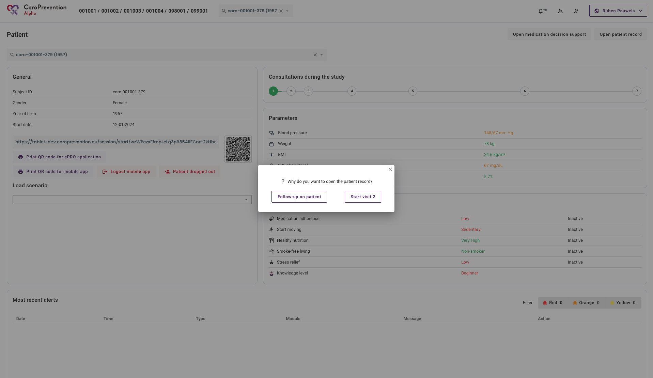

Slide 12
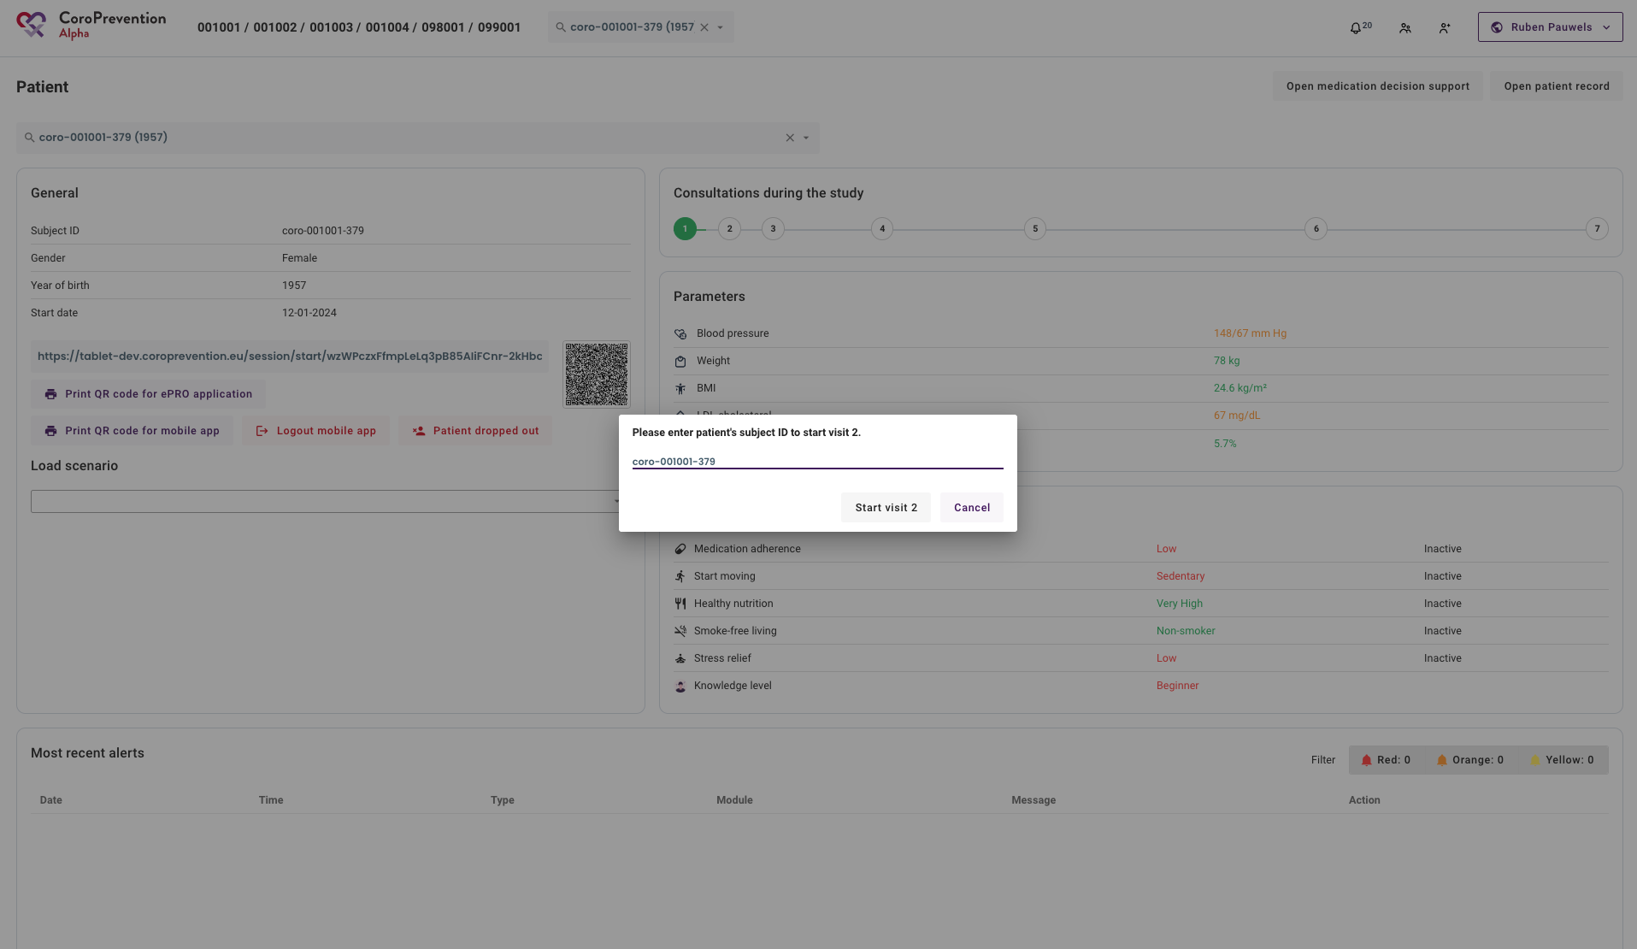

Slide 13
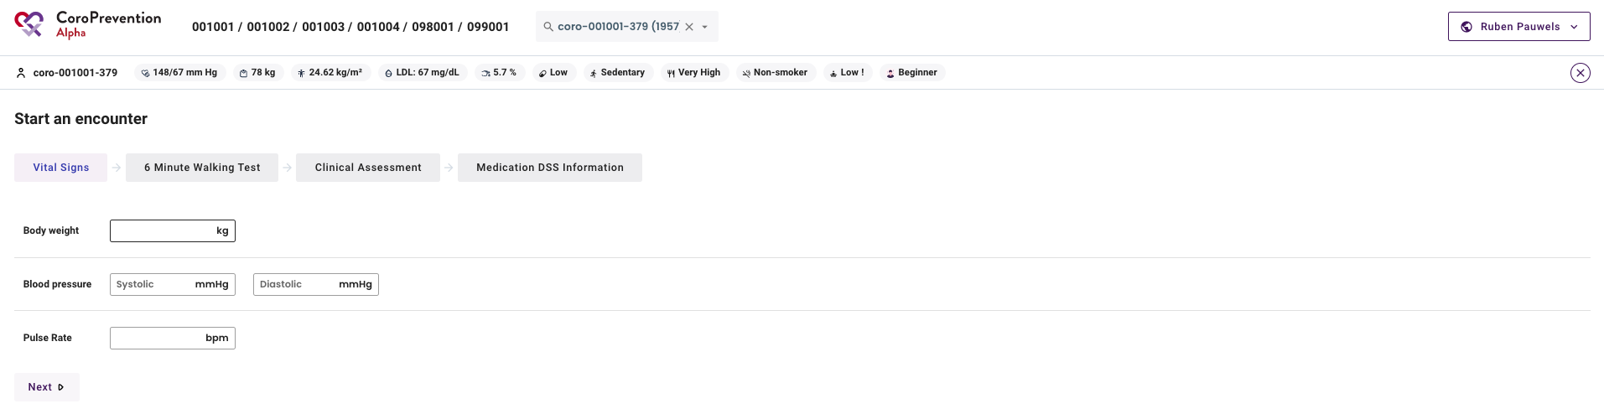

Slide 14
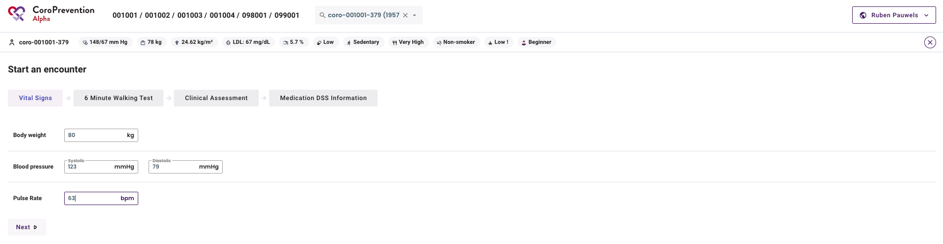

Slide 15
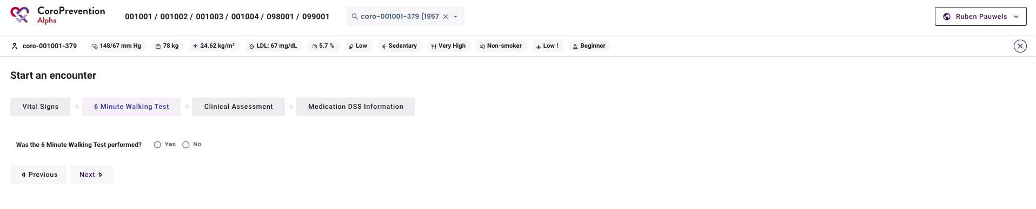

Slide 16
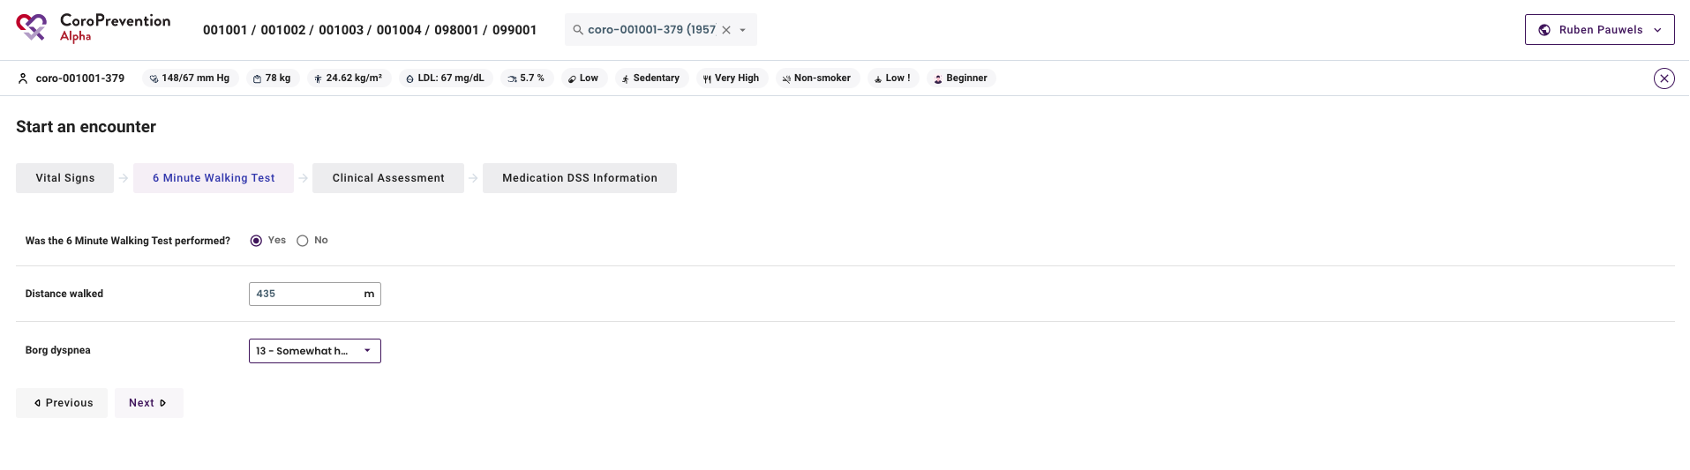

Slide 17
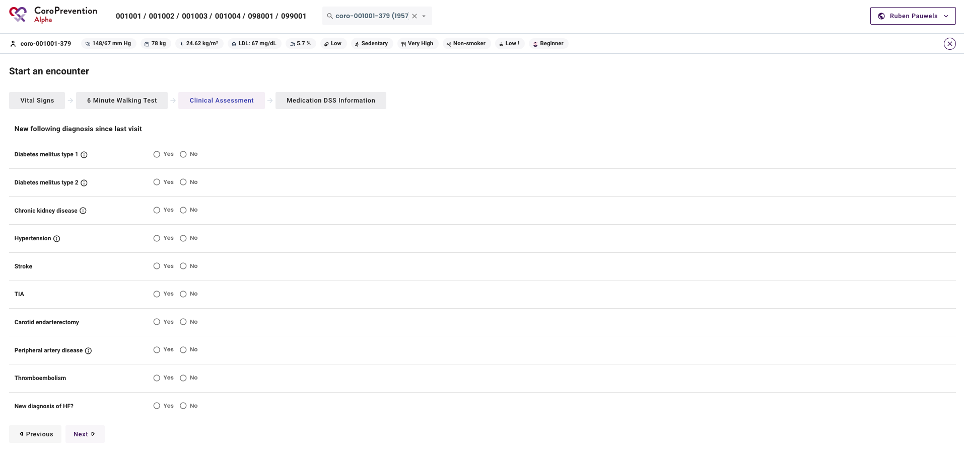

Slide 18
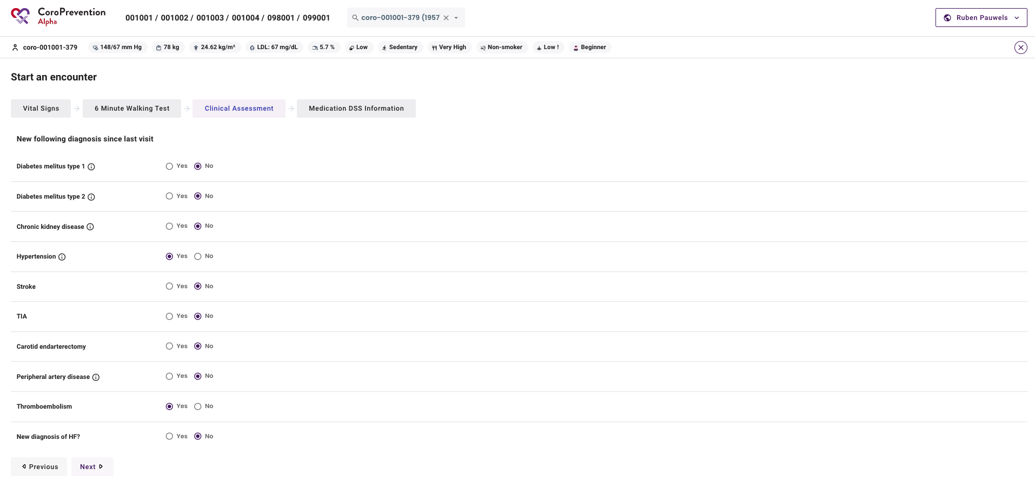

Slide 19
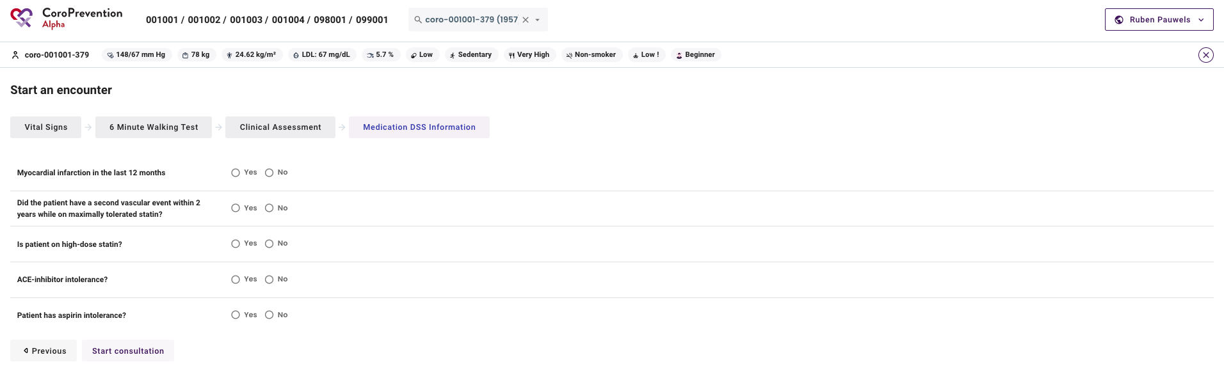

Slide 20
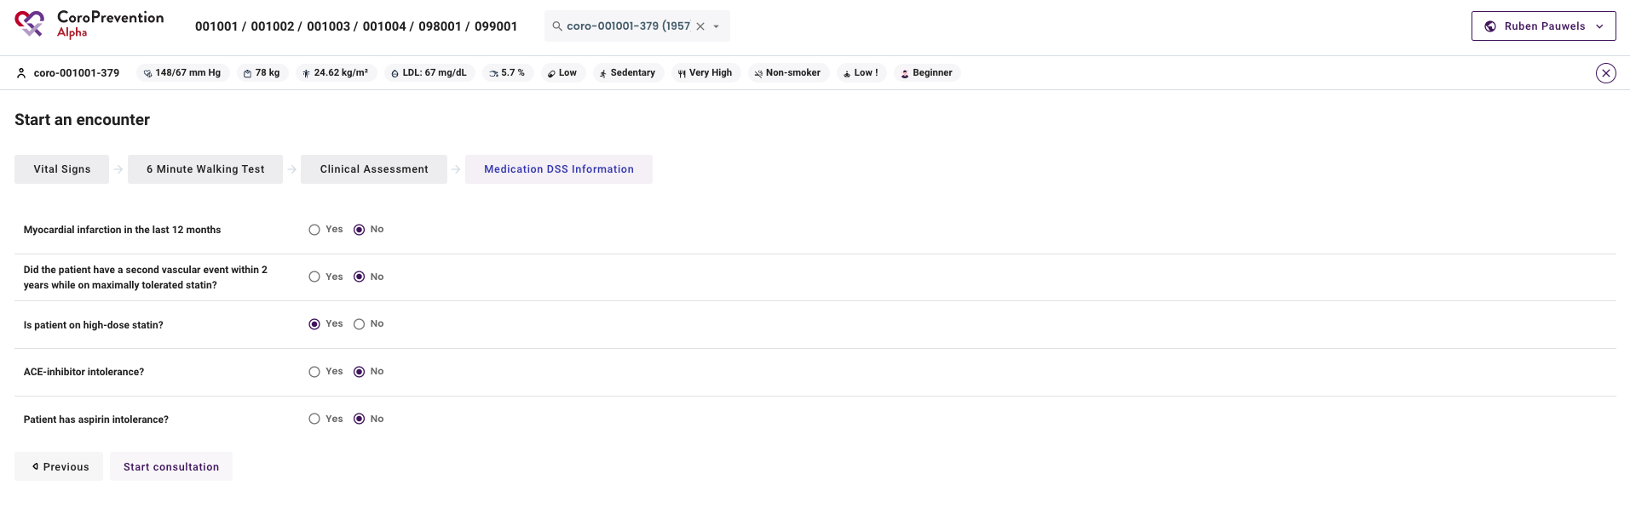

Slide 21
Questionnaires
Check if the questionnaires have been completed. If not, you can help the patient with completing the questionnaires.

Slide 22
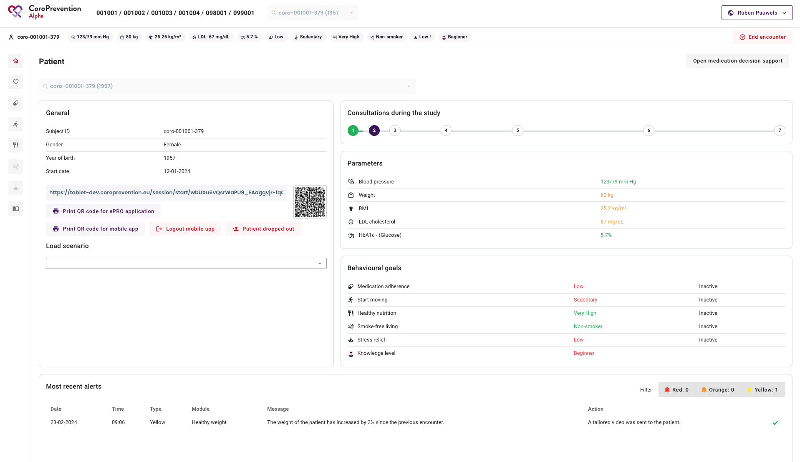

Slide 23
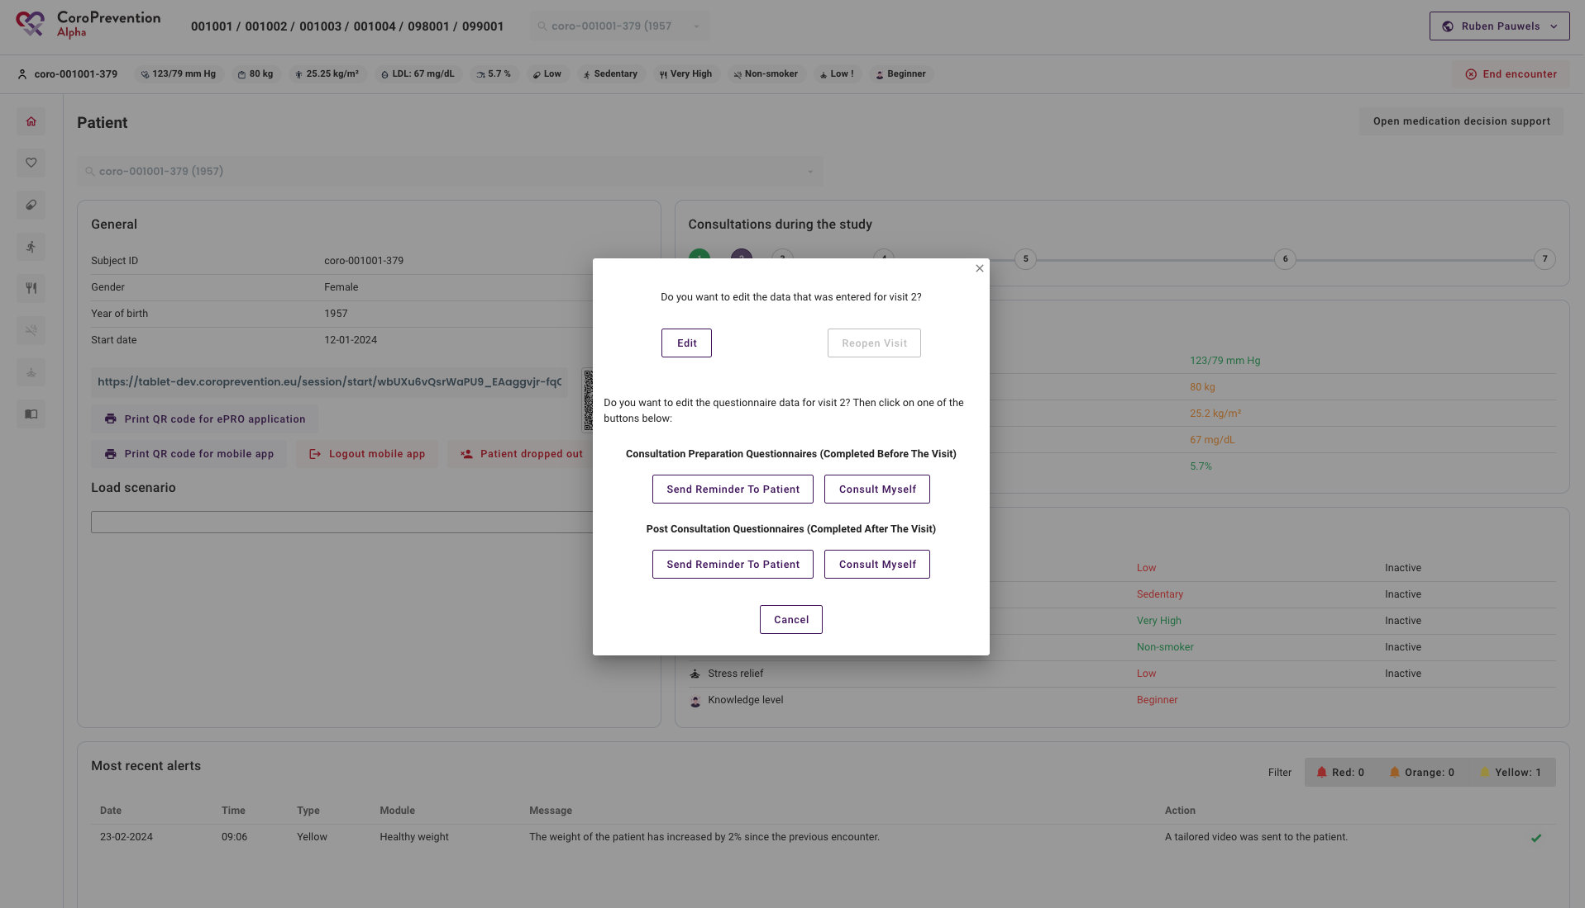

Slide 24
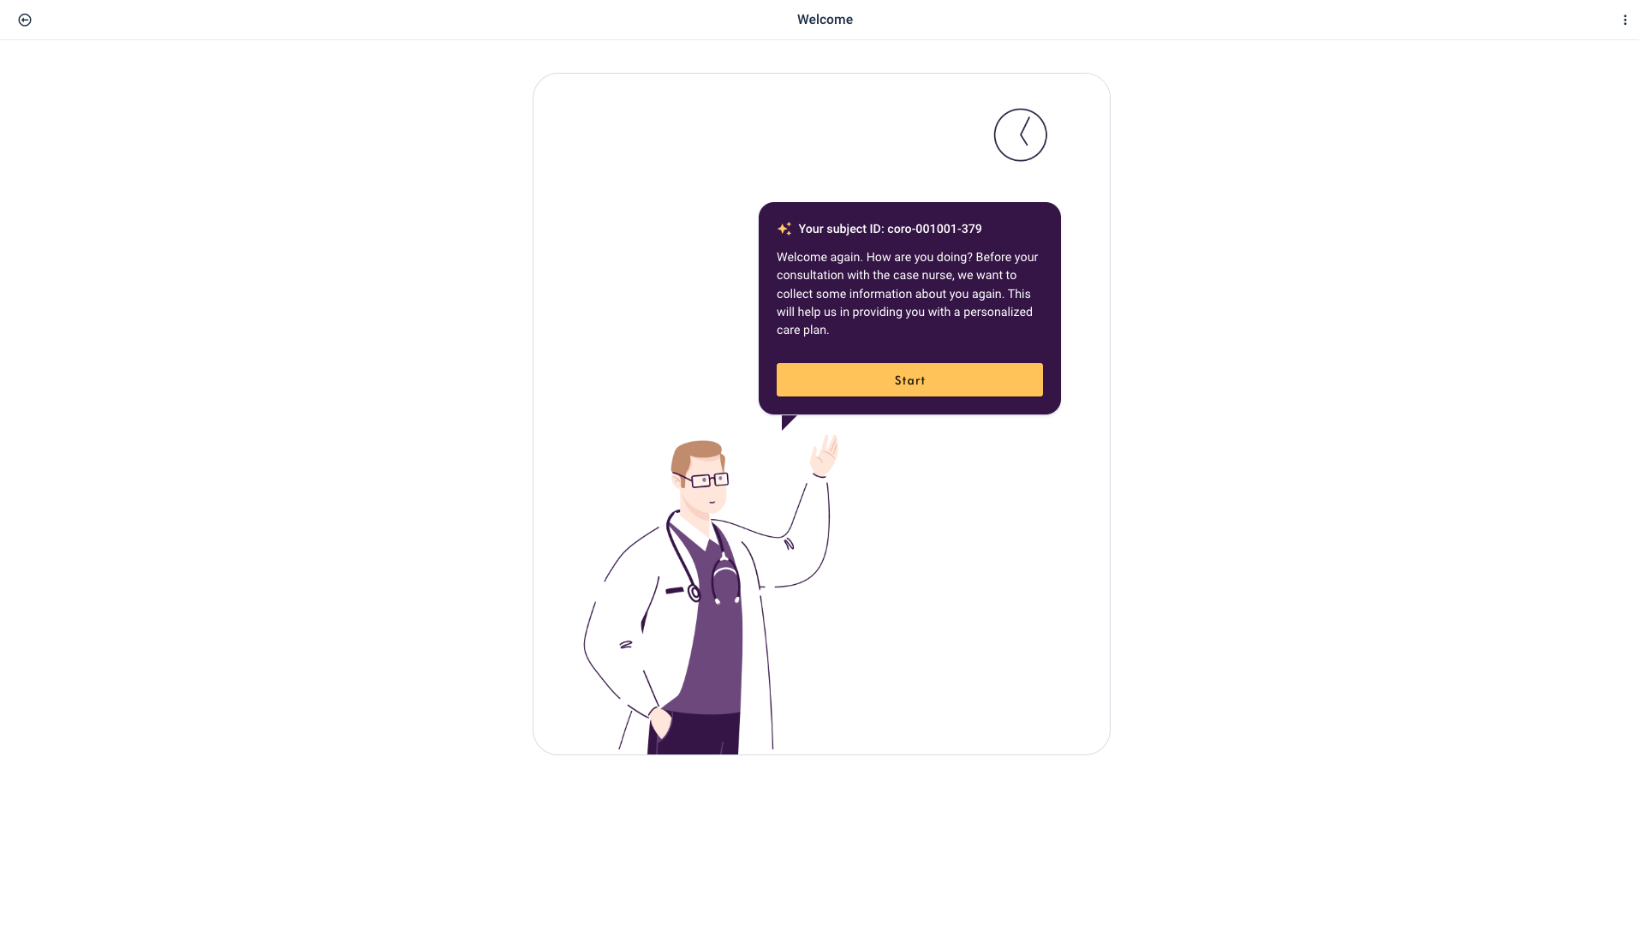

Slide 25
Main part of the patient consultation
From this moment on, the screen will be shared with the patient, and the patient is invited to follow everything you will do on the screen.
Shall we take a look together at where you are at now?

Slide 26


Slide 29
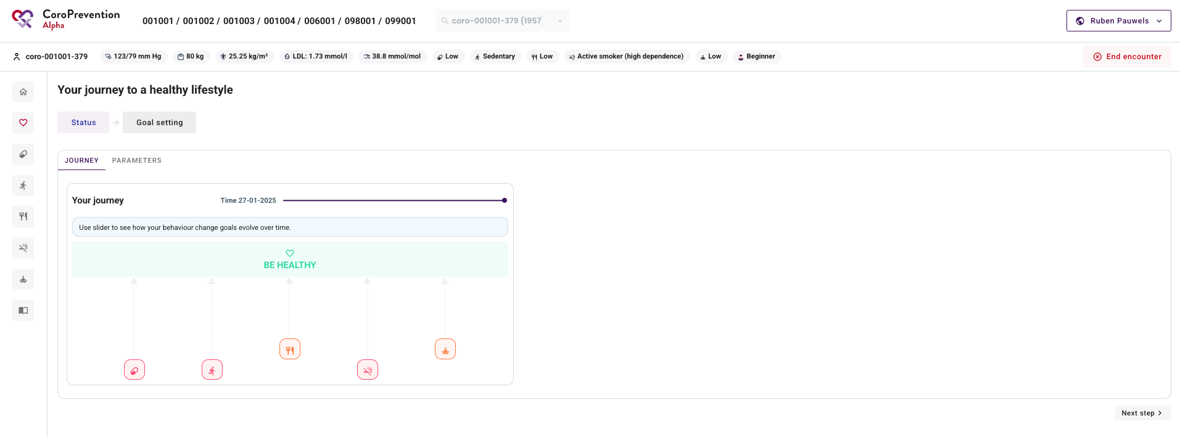

Slide 30
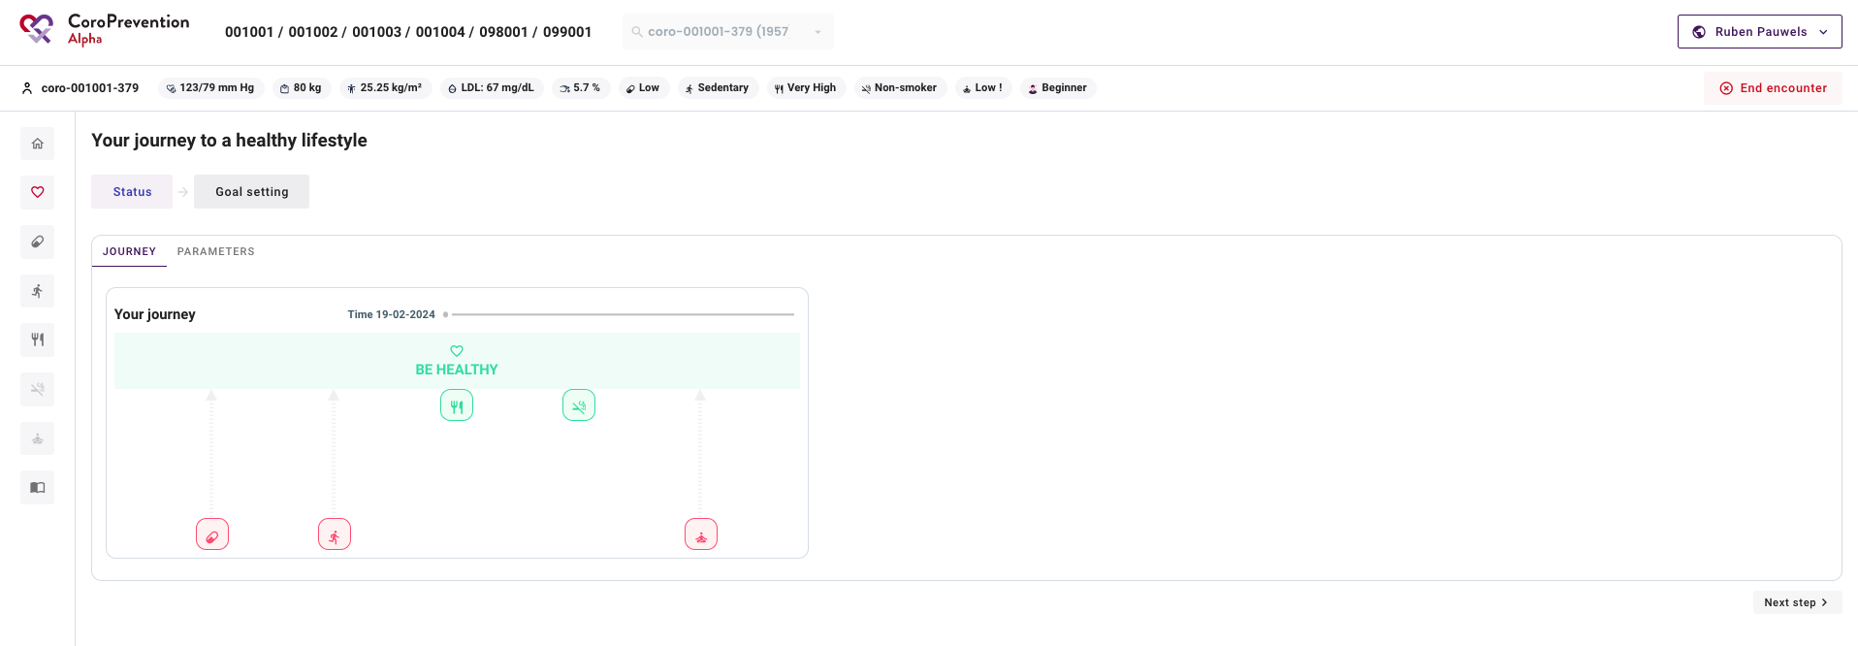


Slide 31
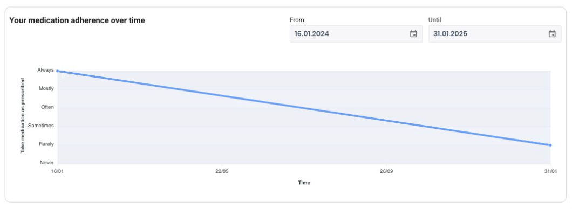

Slide 33
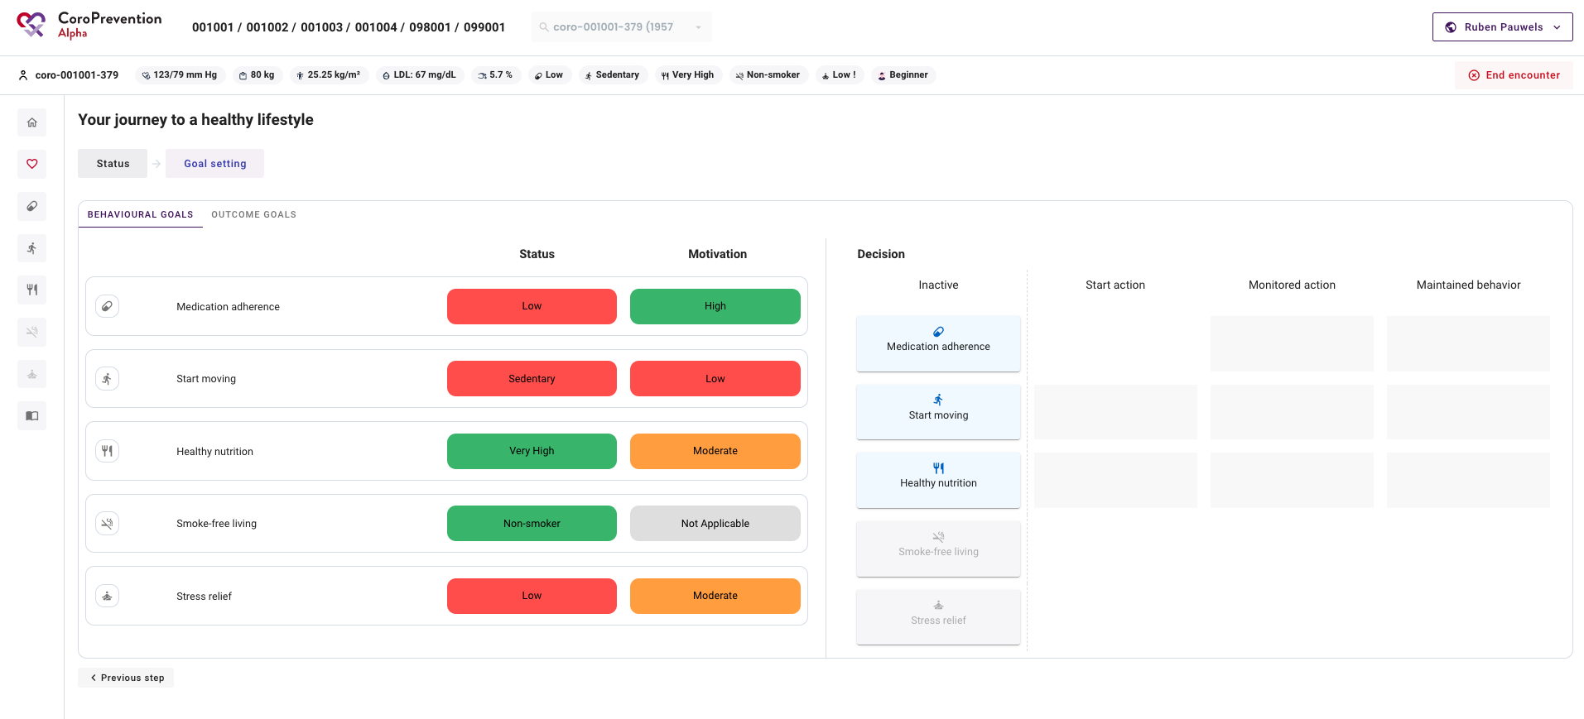

Slide 36
Module by module
For each module you will look at the overview and decide together with the patient if he/she wants to change the behaviour. If so, you can do detailed goal-setting per goal.

Slide 37
Medication adherence

Slide 38
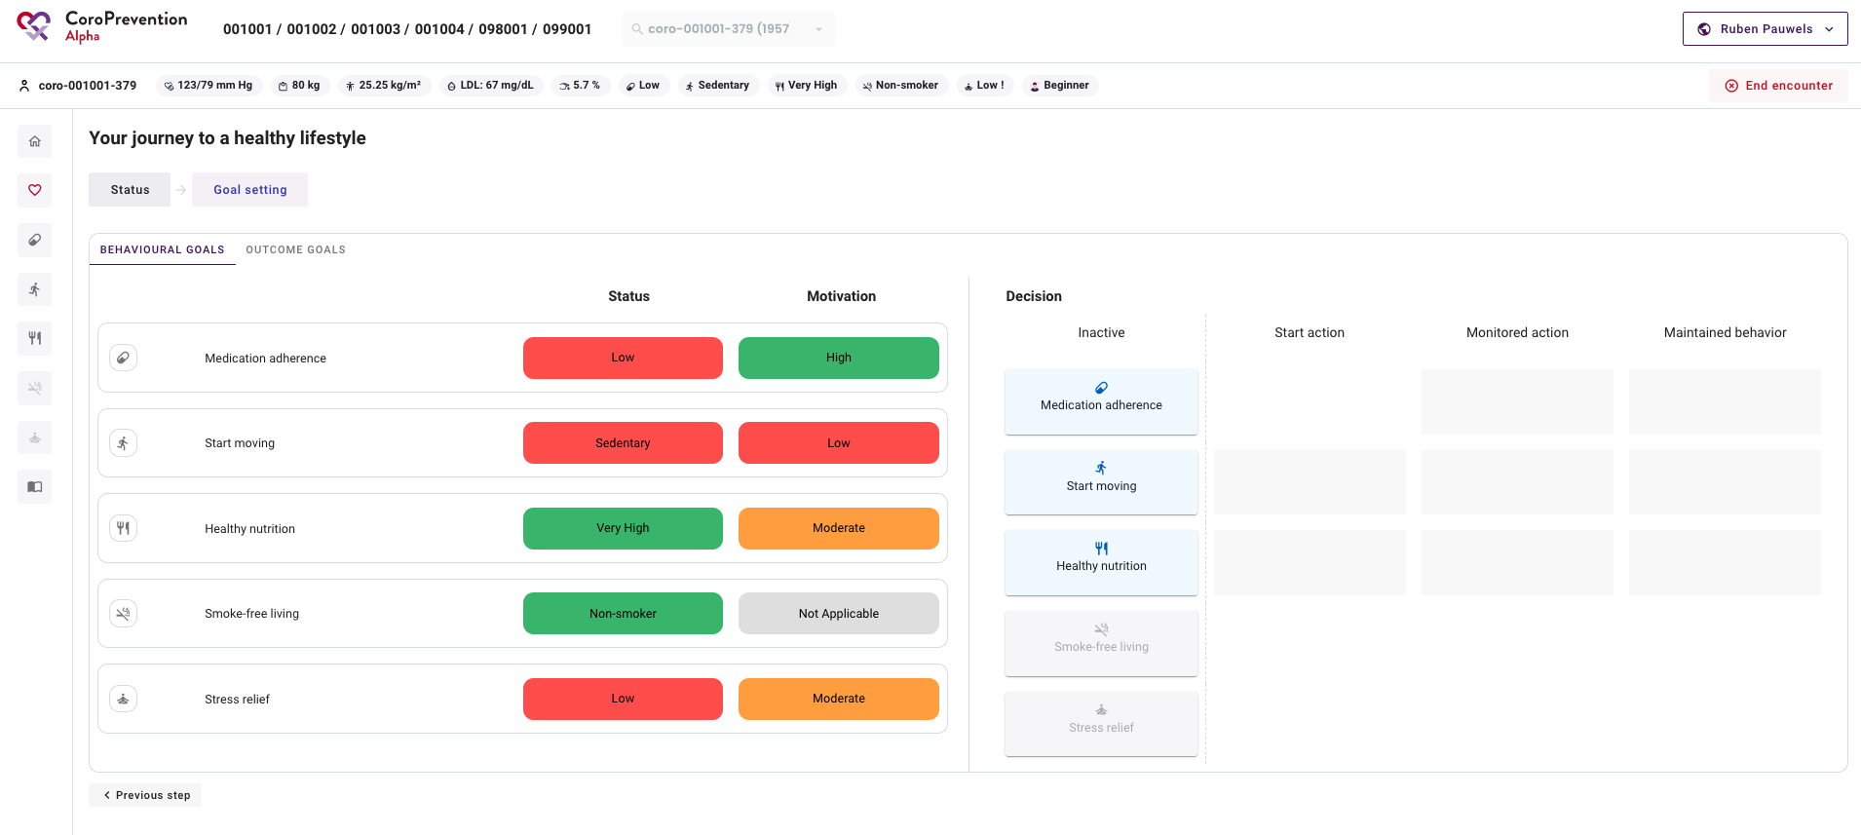

Slide 40
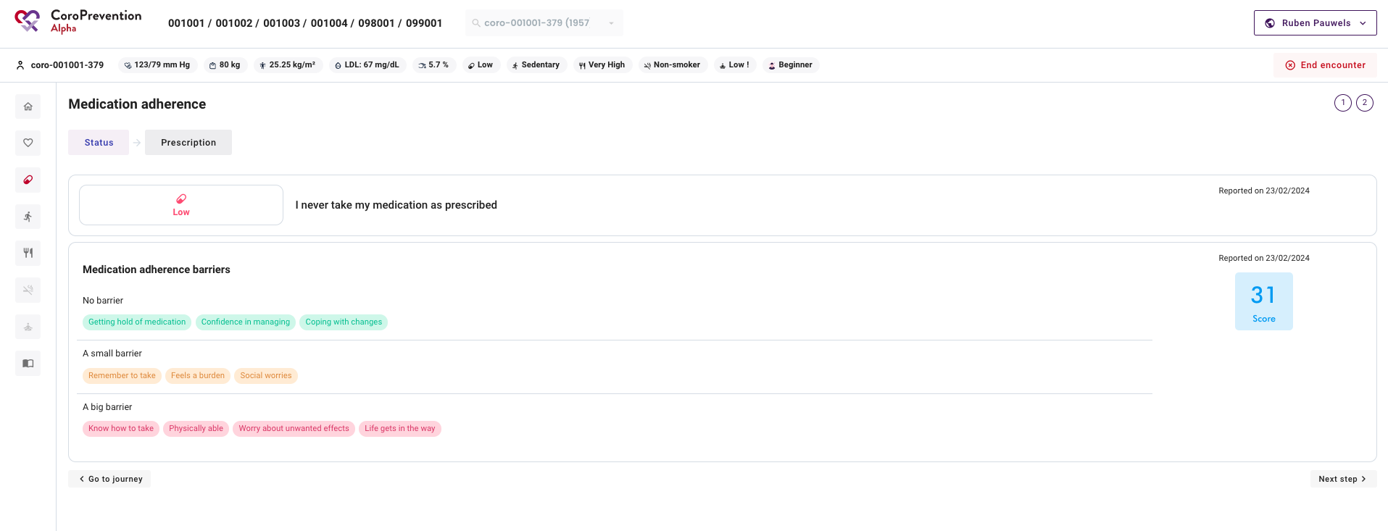

Slide 42
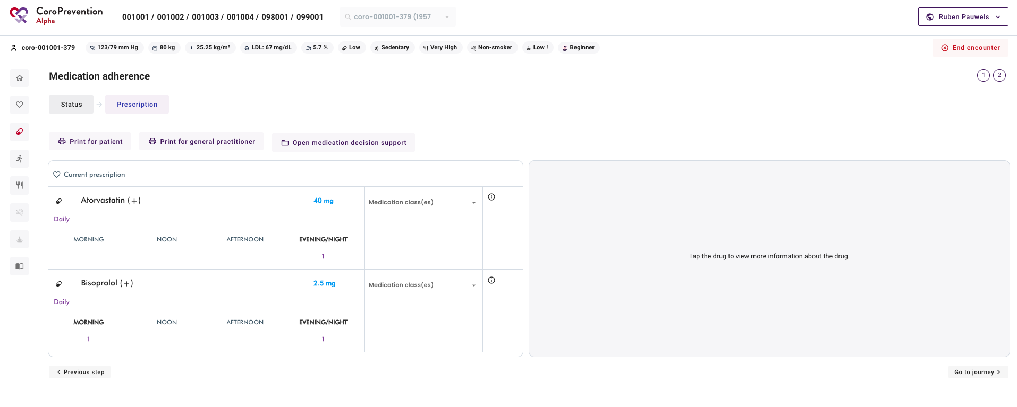

Slide 44
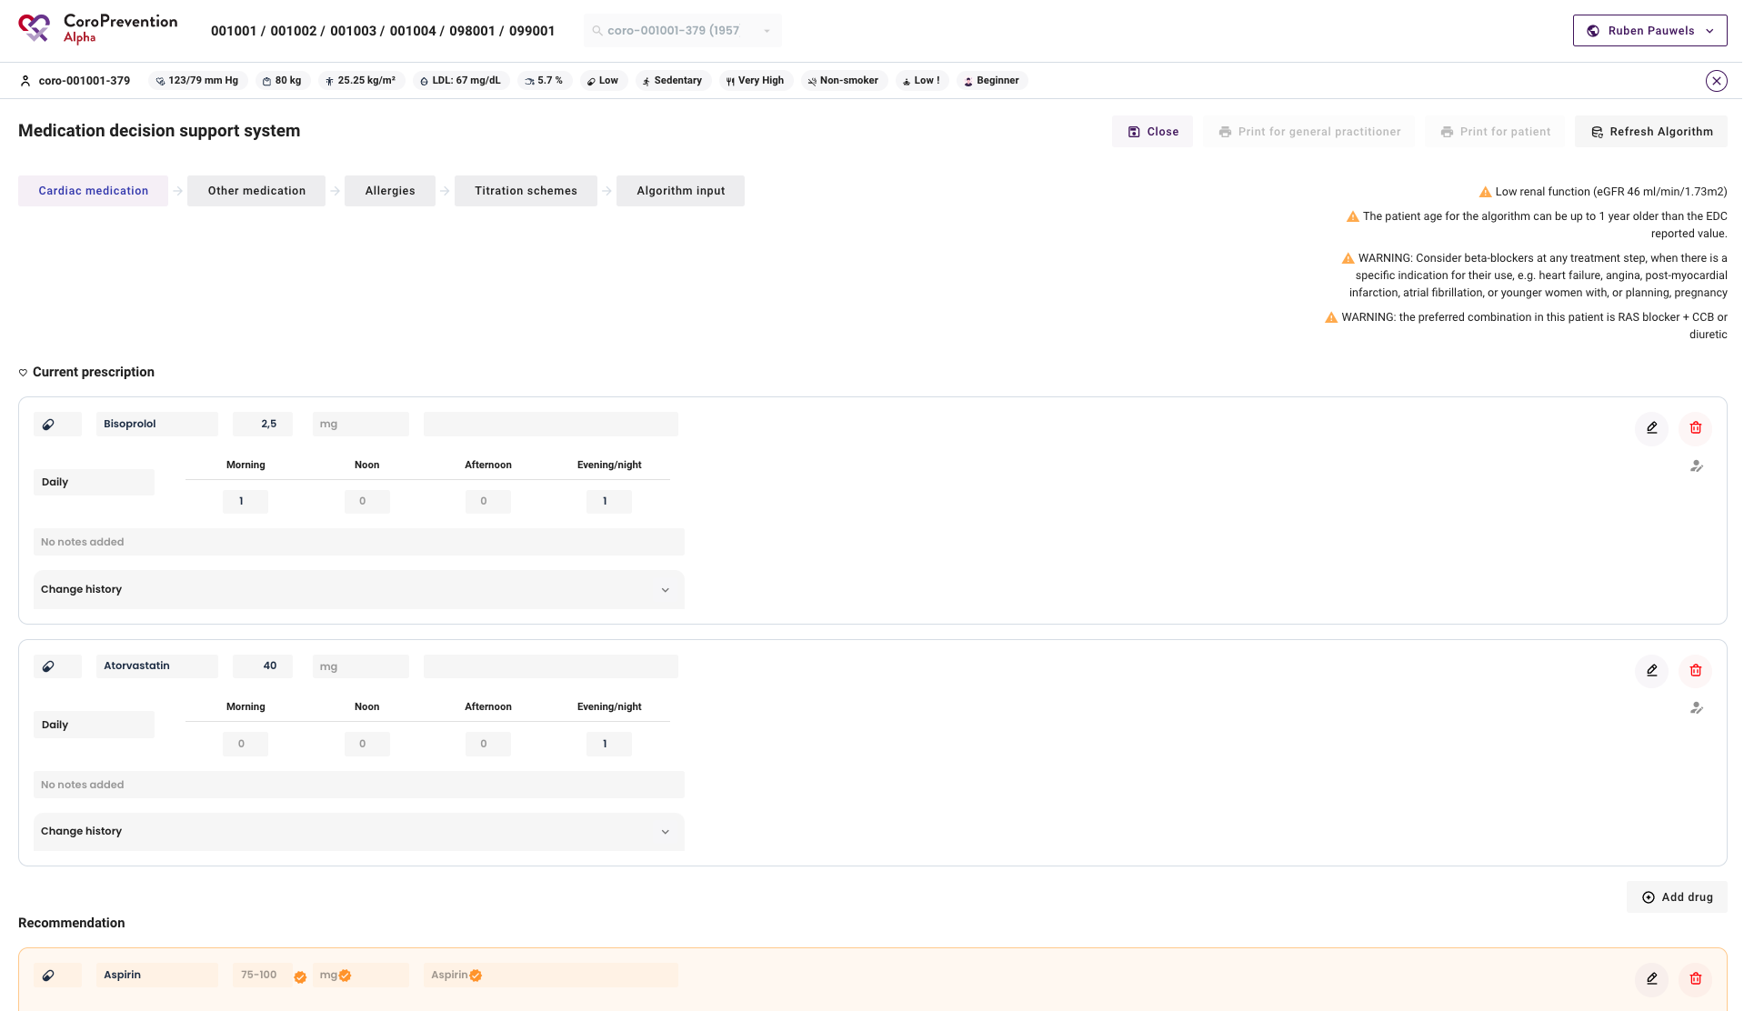

Slide 45
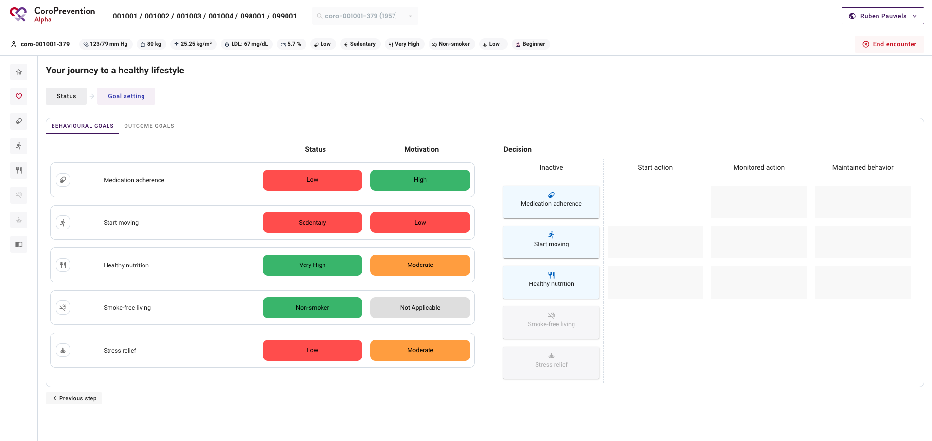

Slide 46
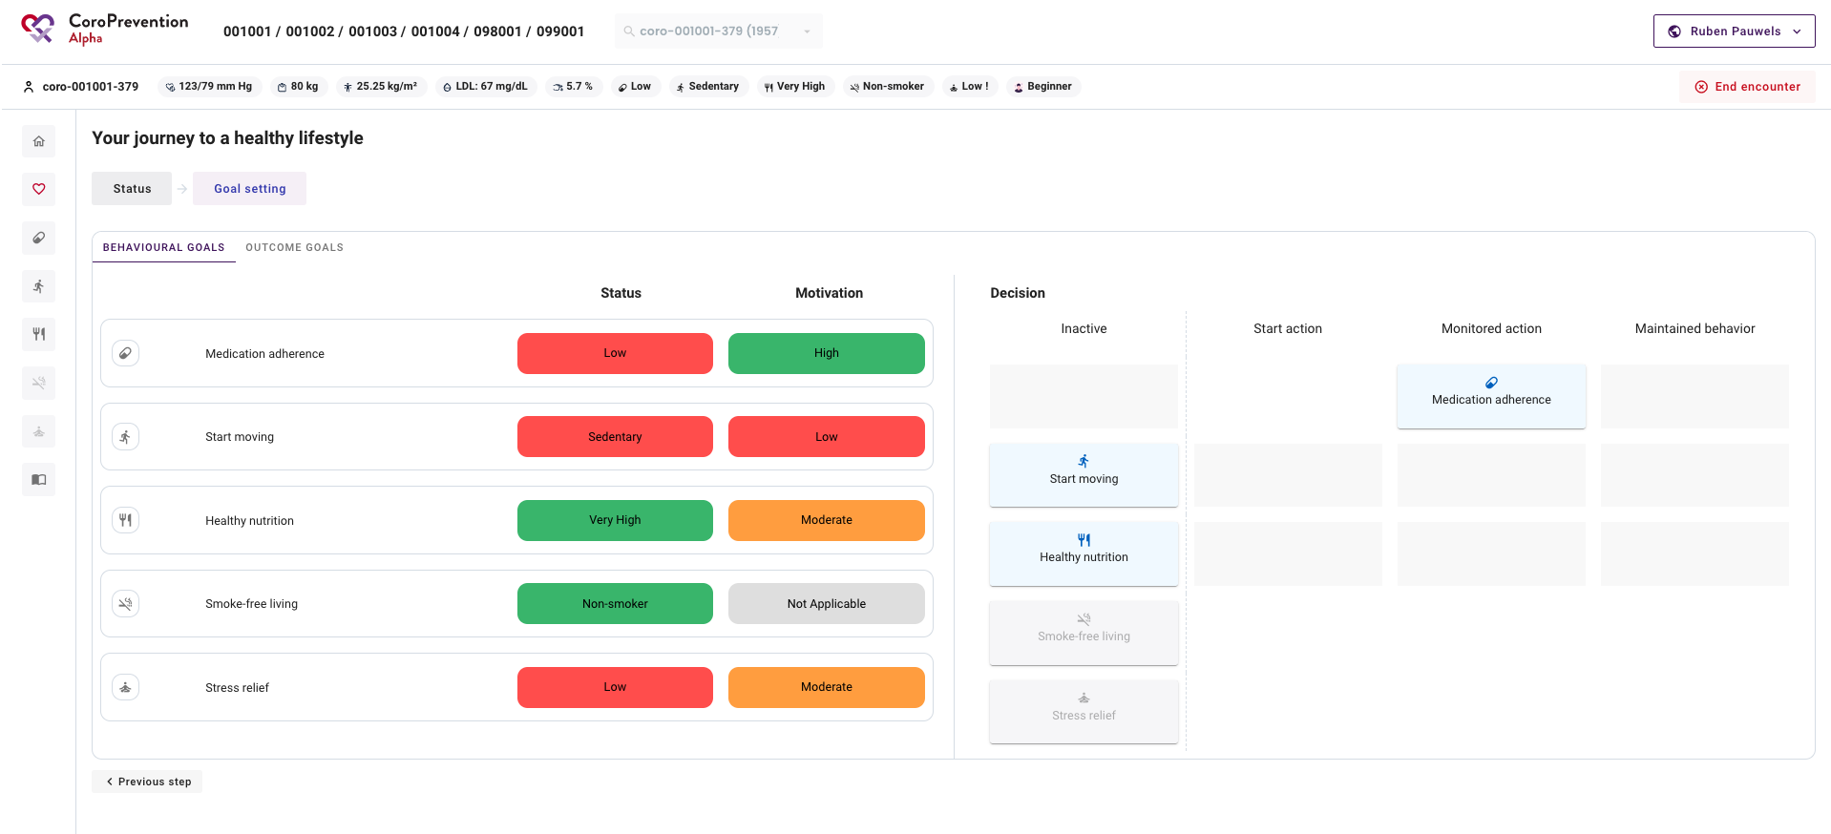

Slide 47
Start moving

Slide 48
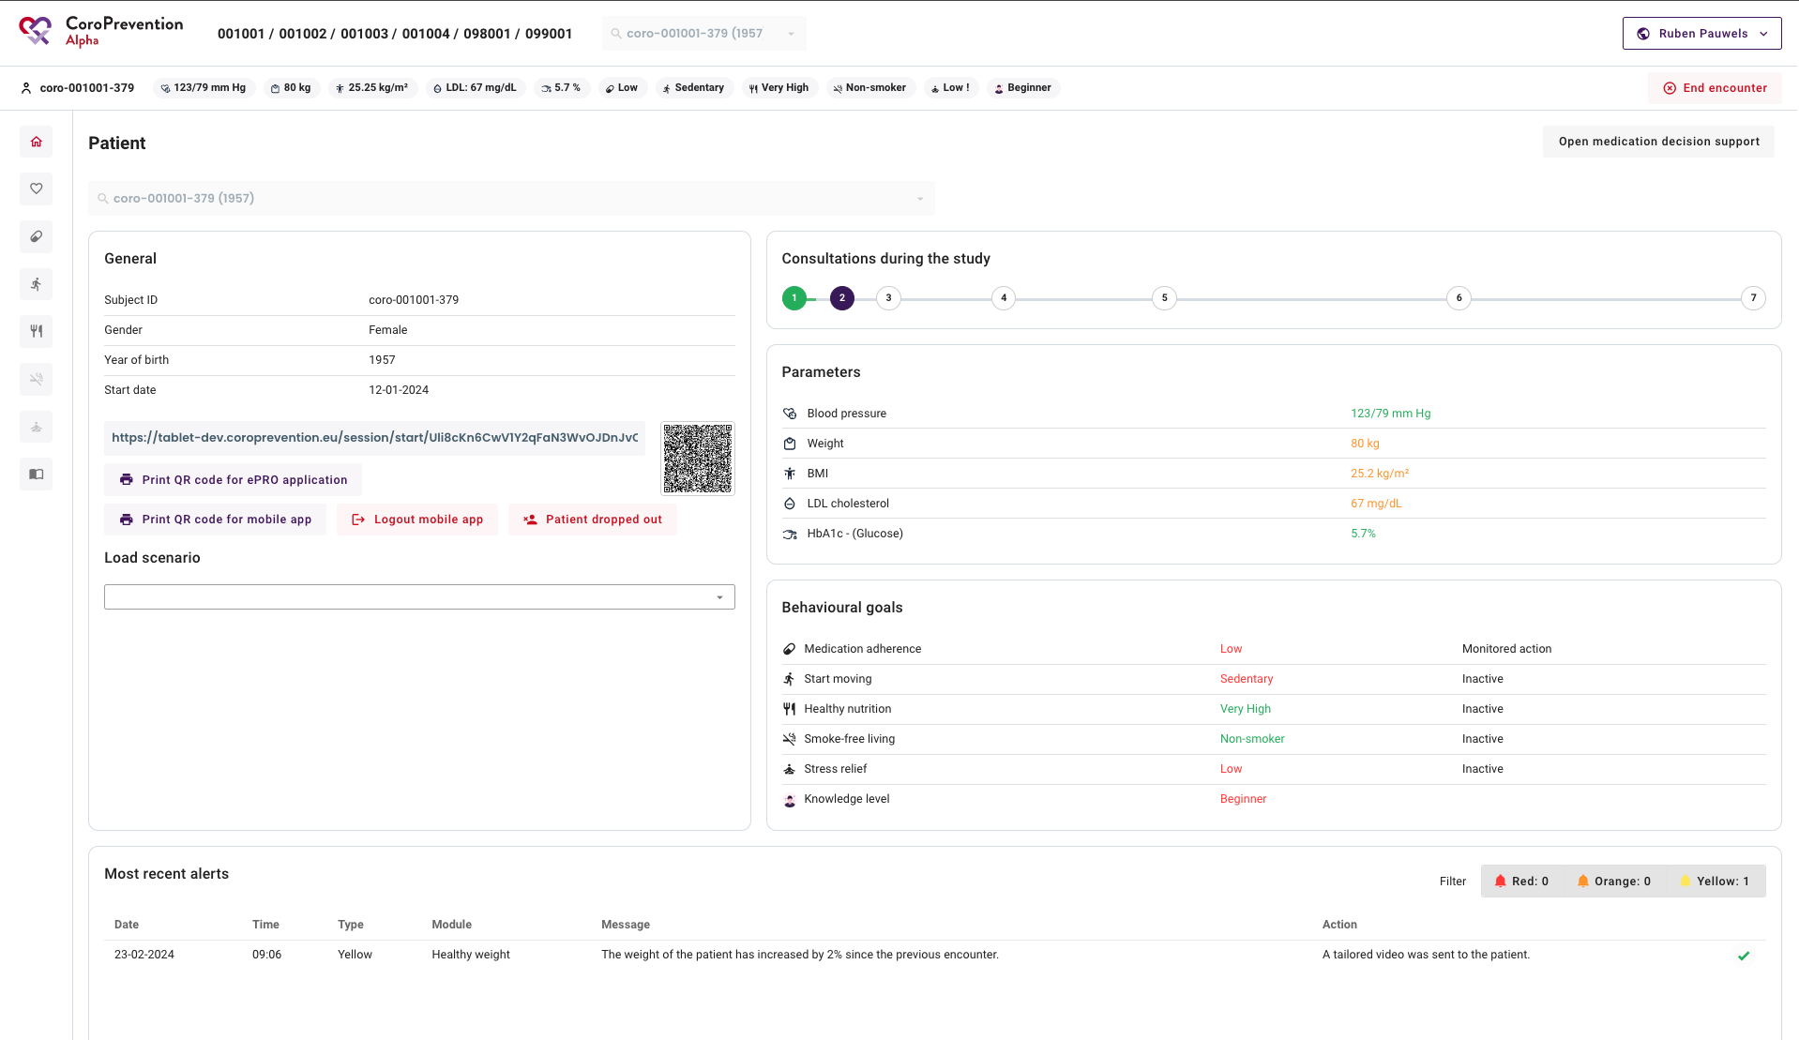

Slide 49
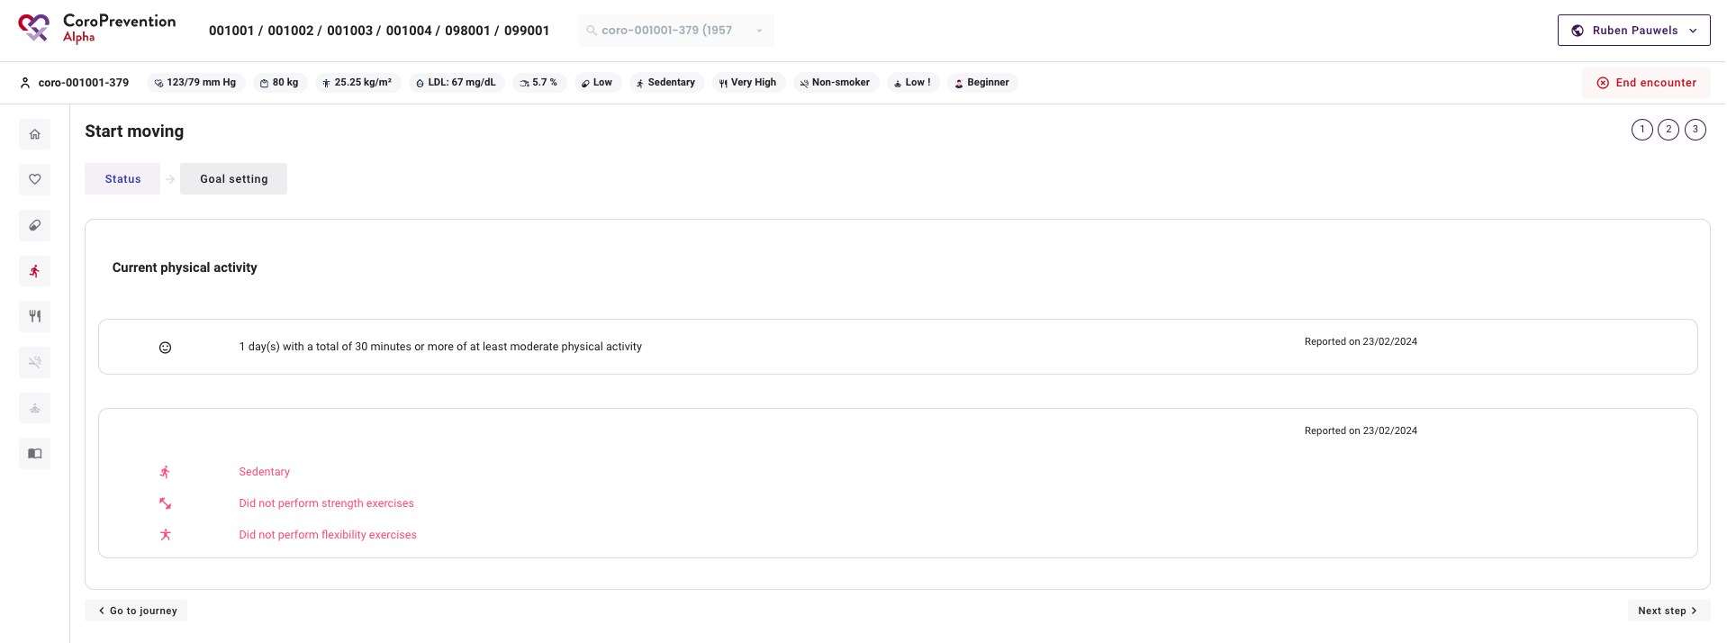

Slide 51
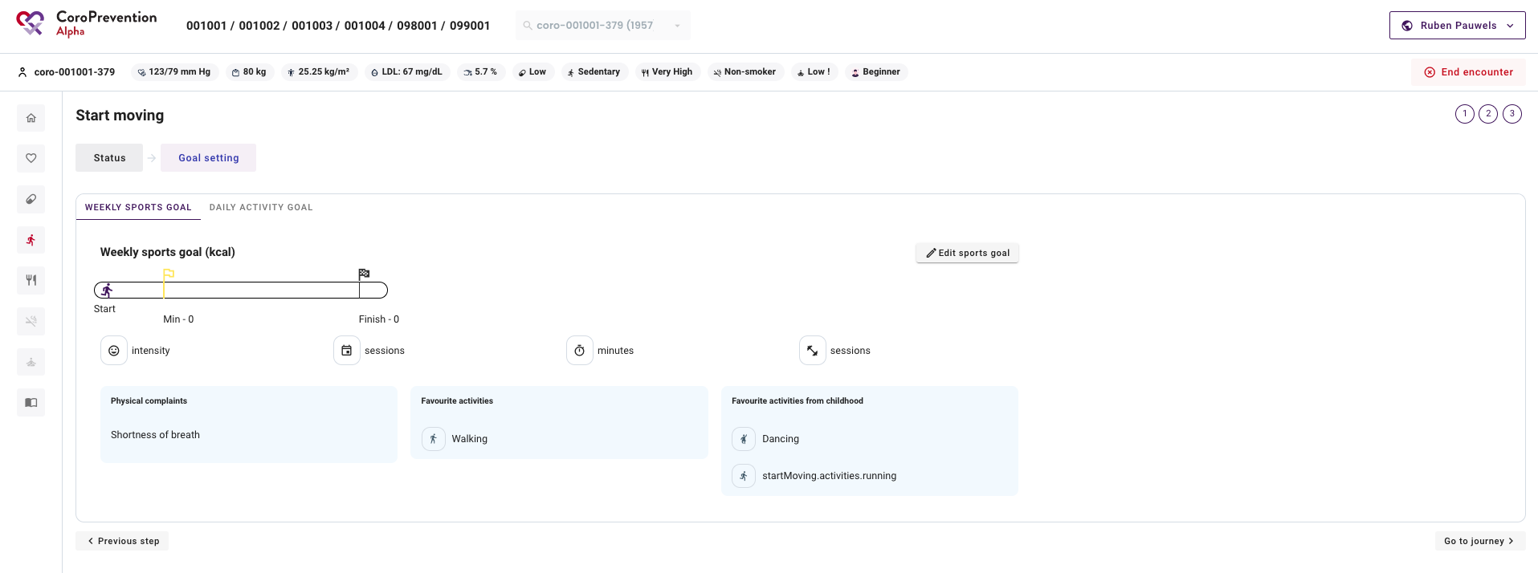
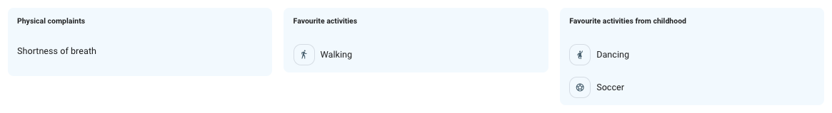

Slide 54
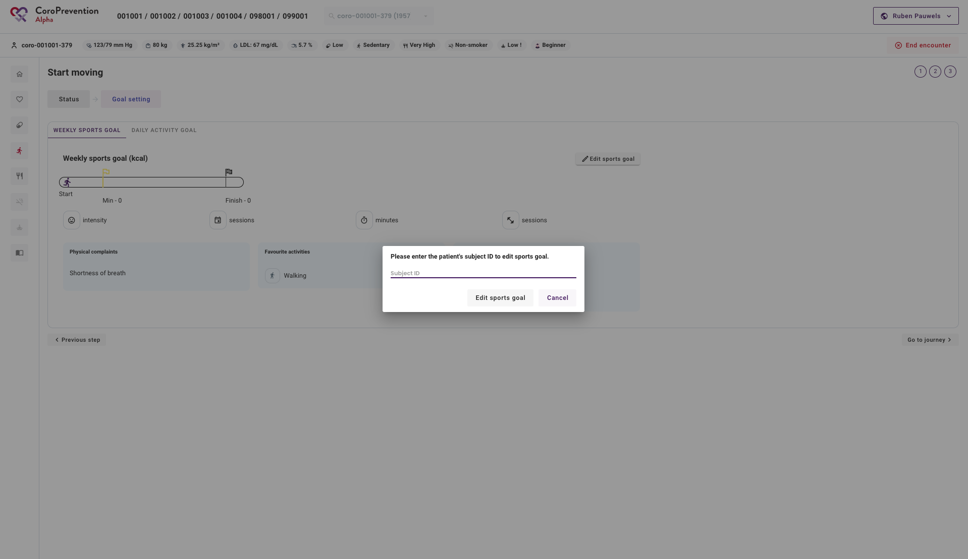

Slide 55
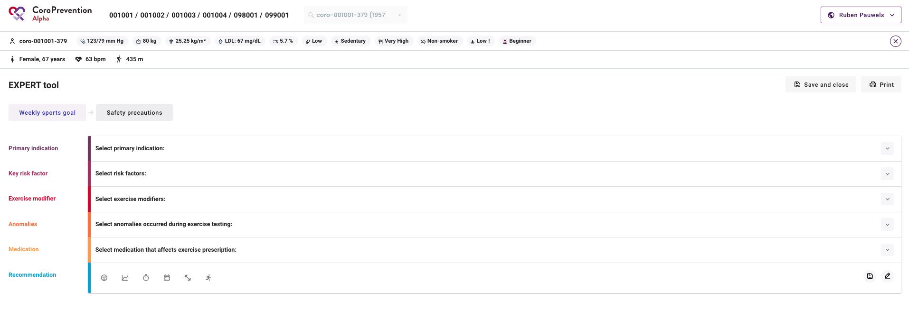

Slide 57
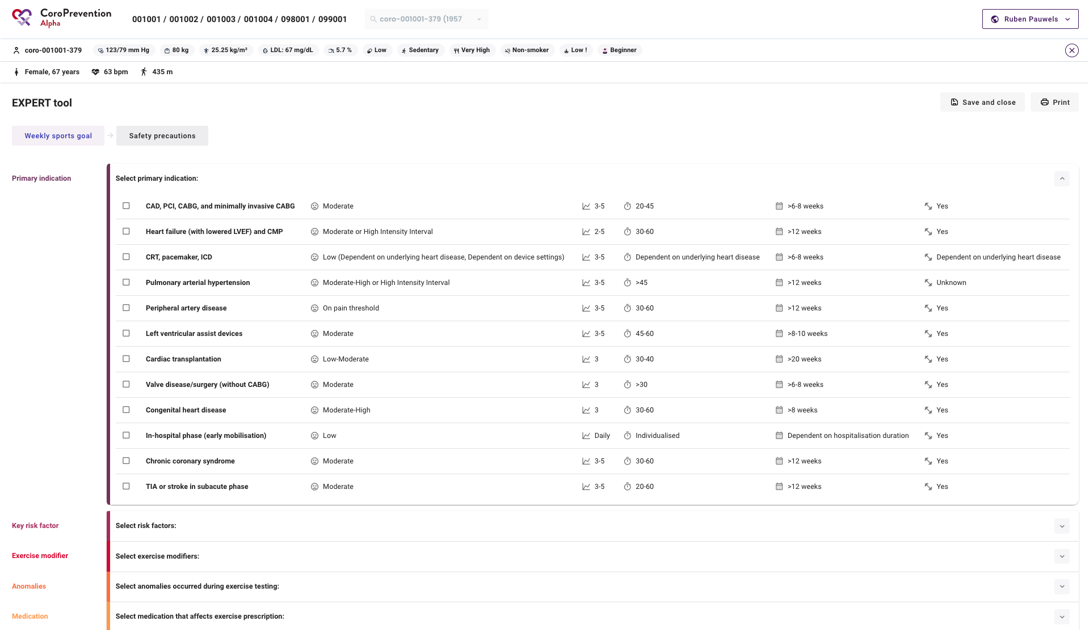

Slide 58
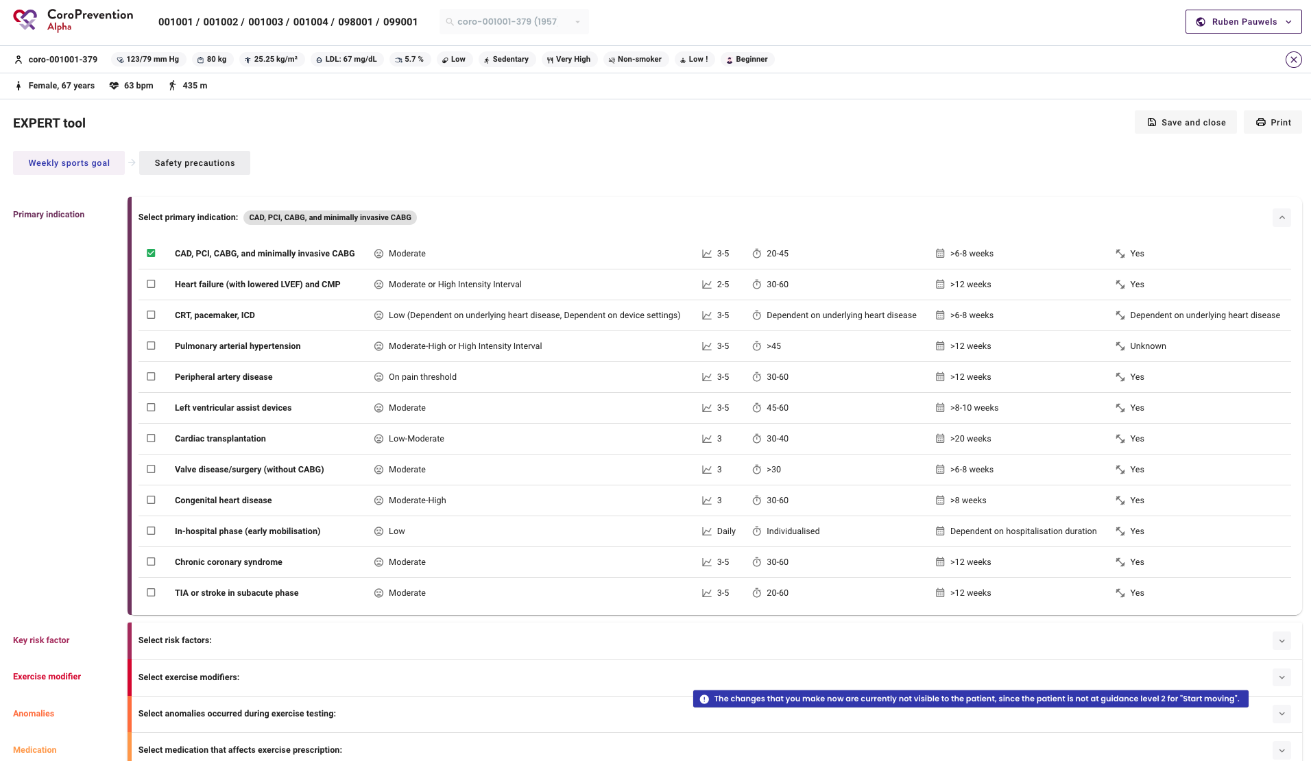

Slide 60
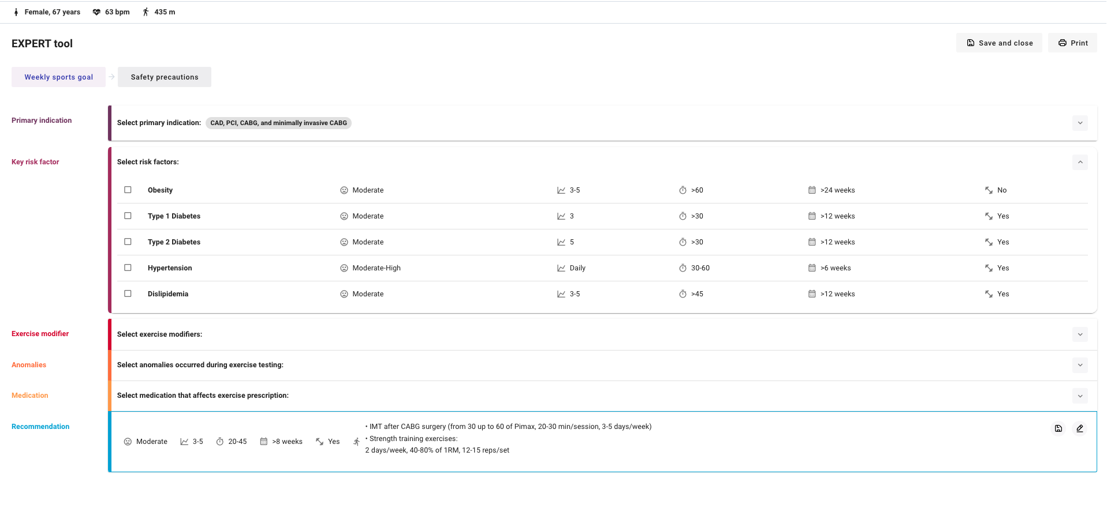

Slide 61
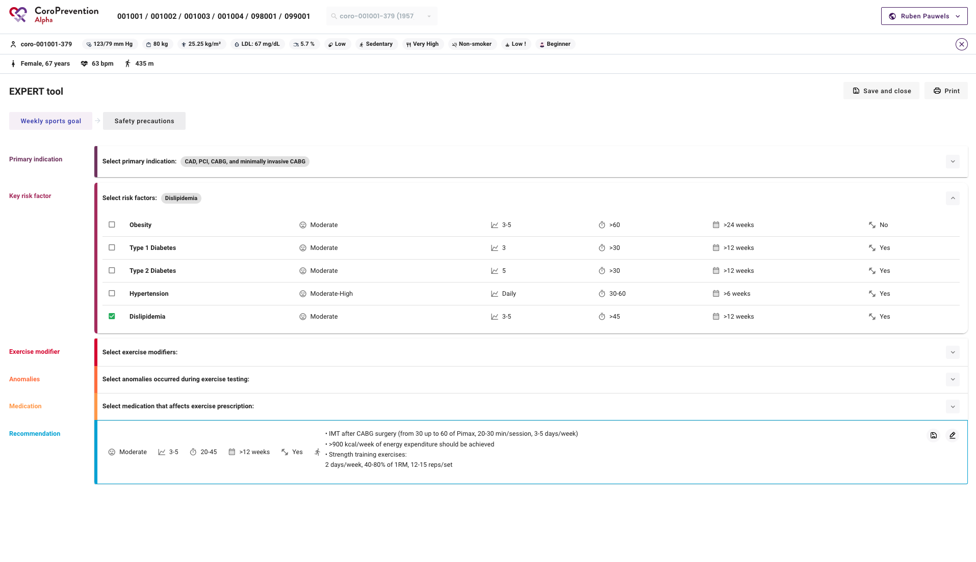

Slide 62
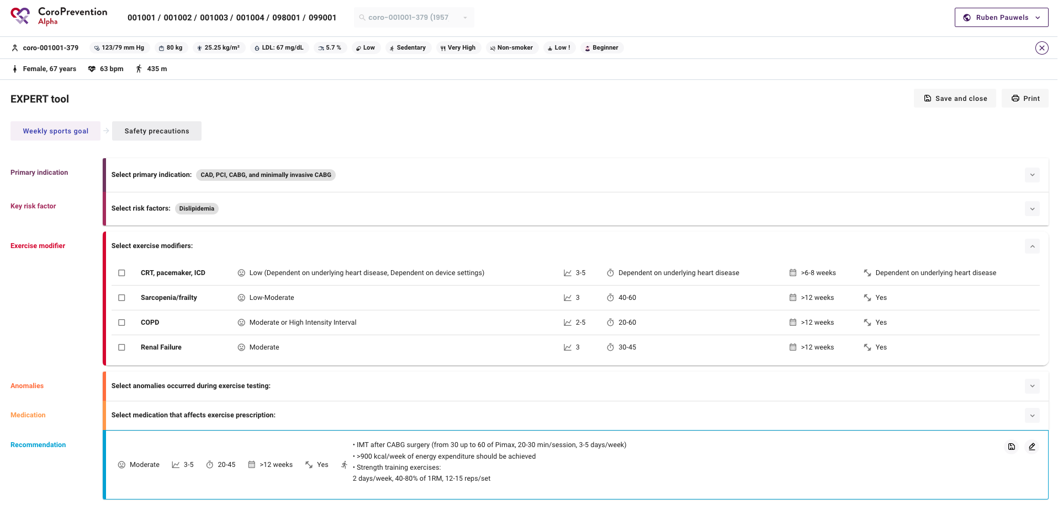

Slide 63
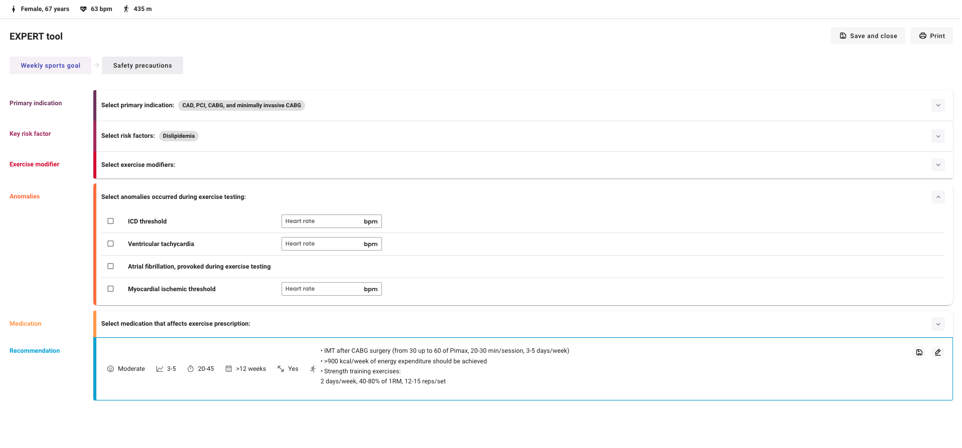

Slide 64
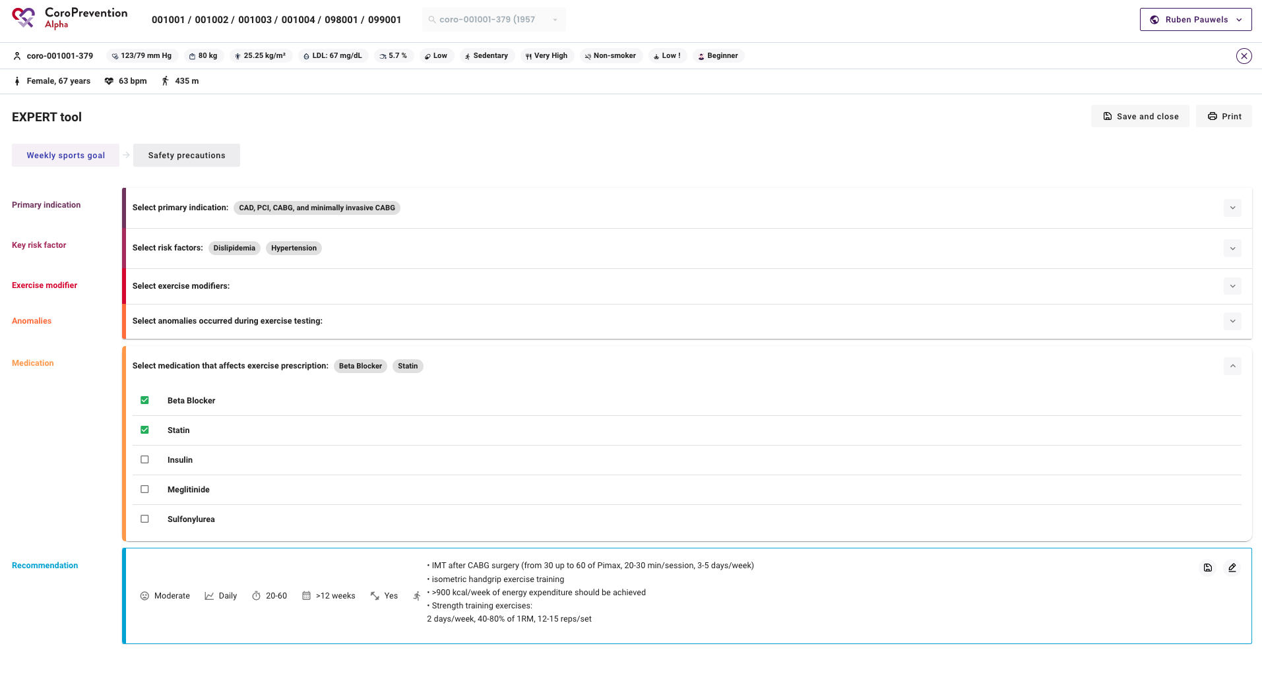

Slide 66
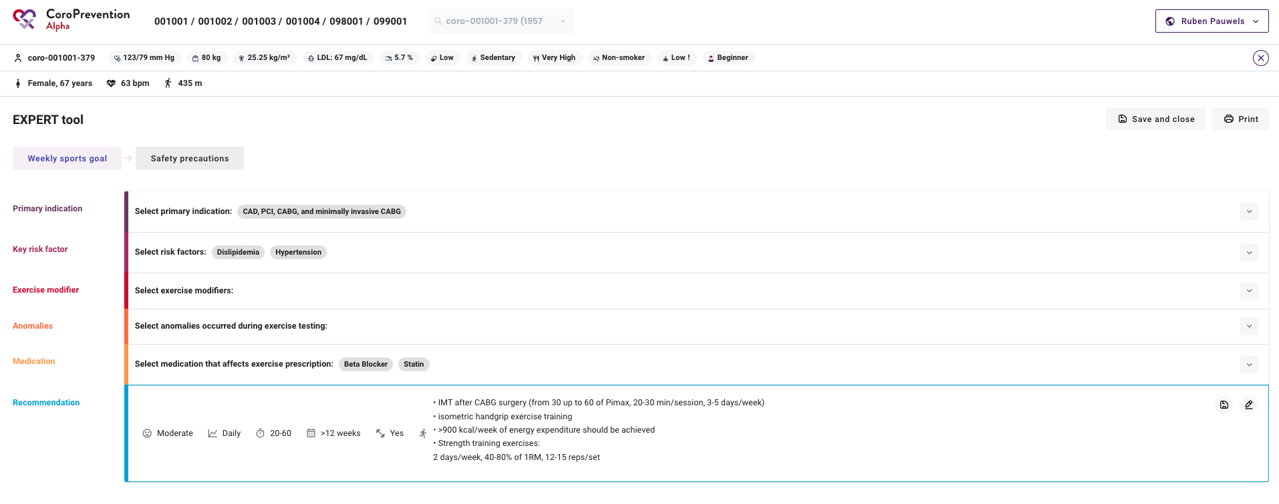

Slide 67
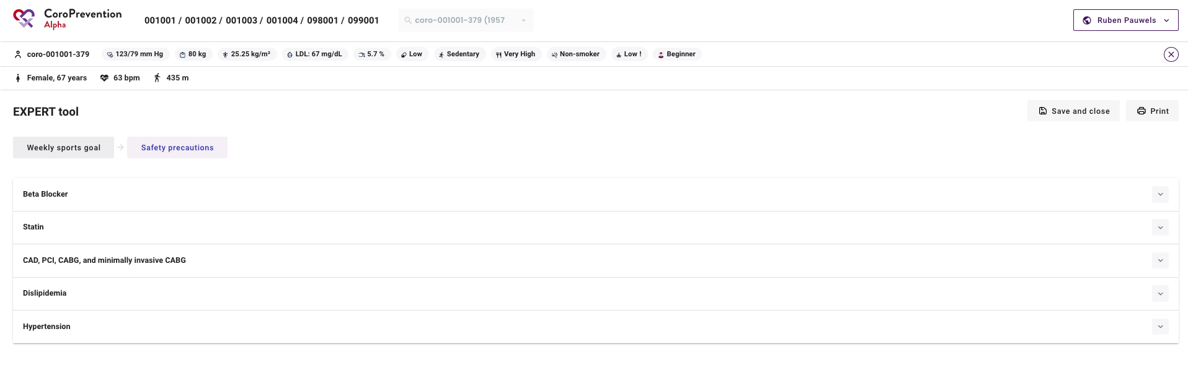

Slide 68
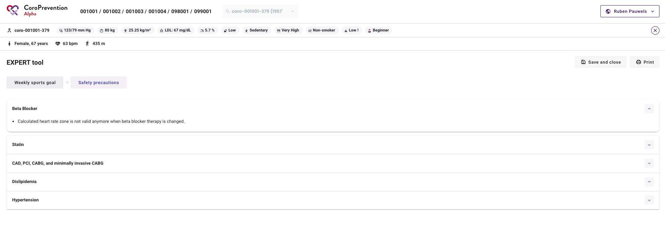

Slide 70
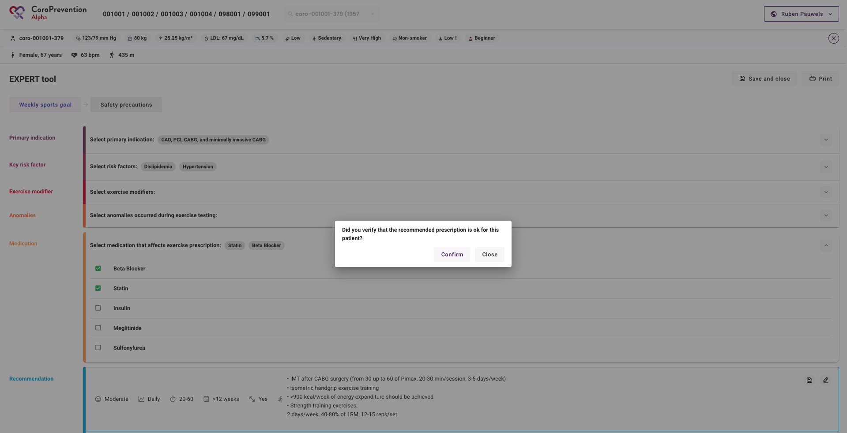

Slide 71
EXPERT tool
It should be noted that the EXPERT tool can already be complete before the consultation.

Slide 72
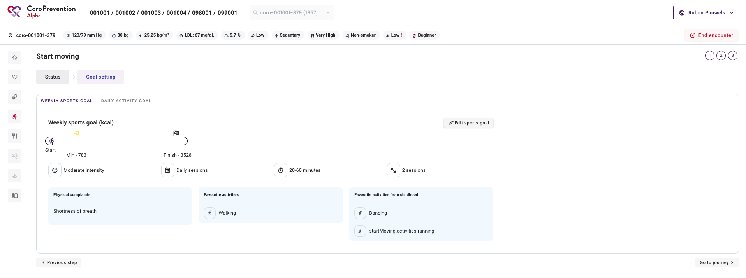

Slide 74
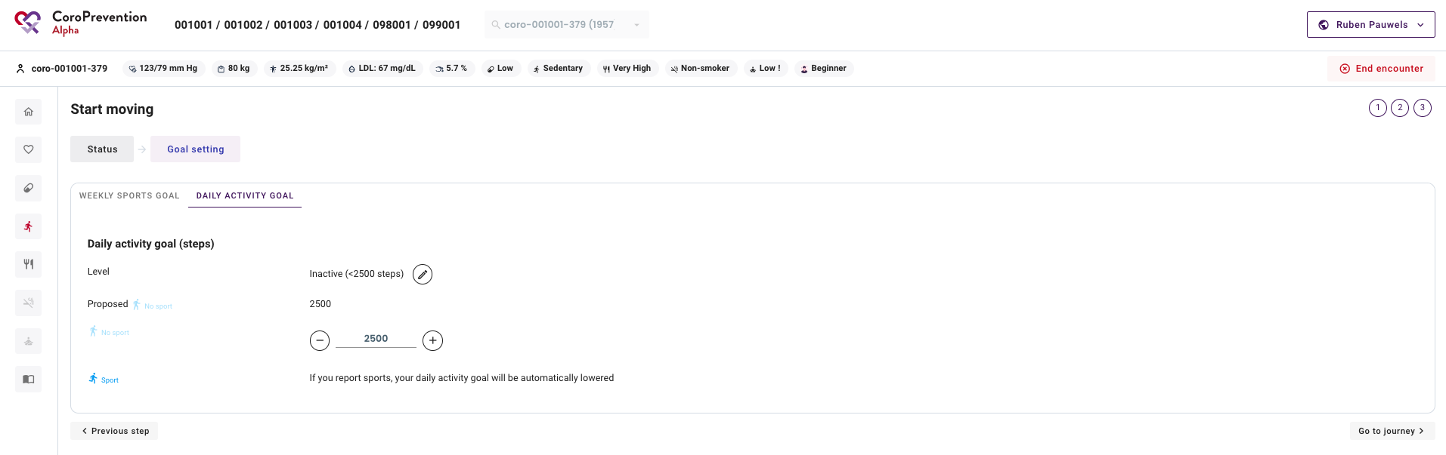

Slide 76
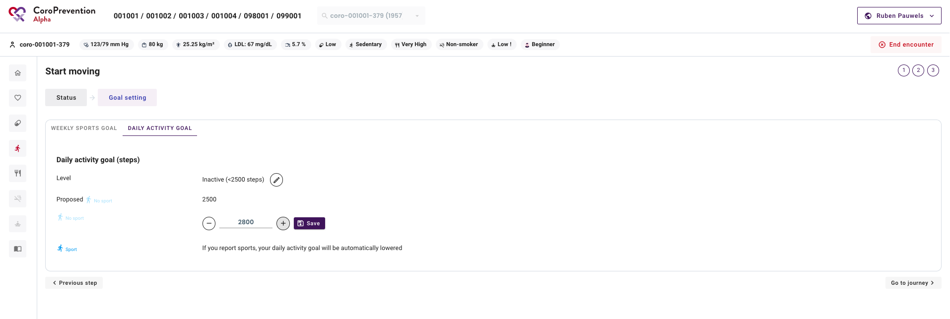

Slide 78
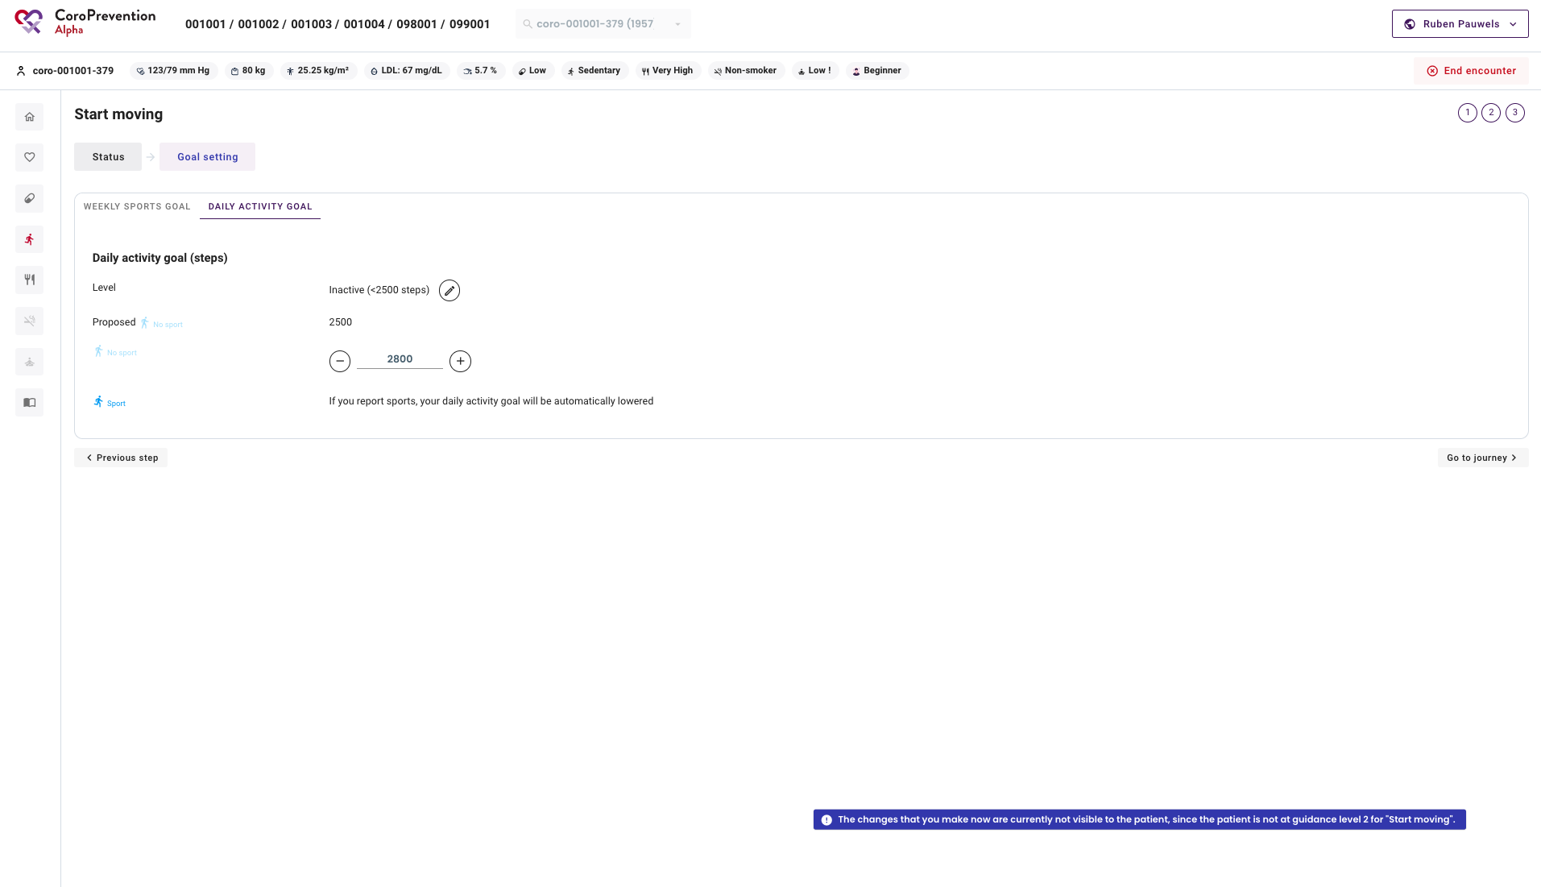

Slide 79
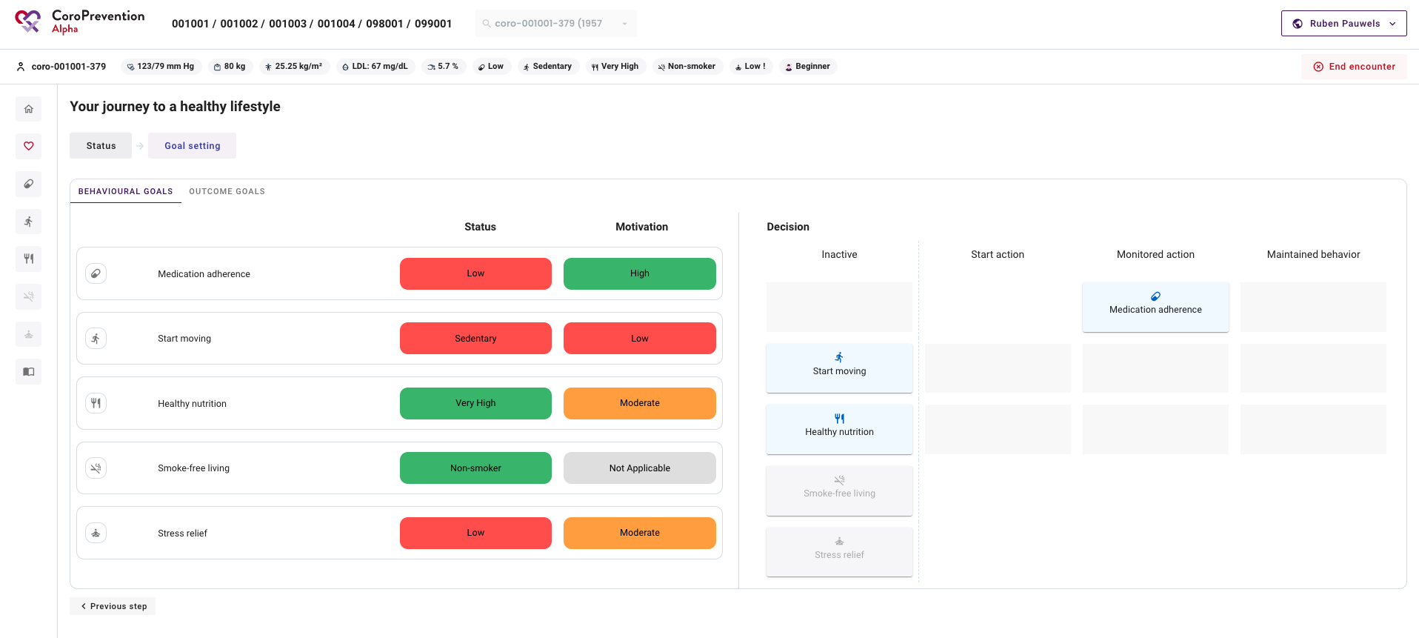

Slide 80
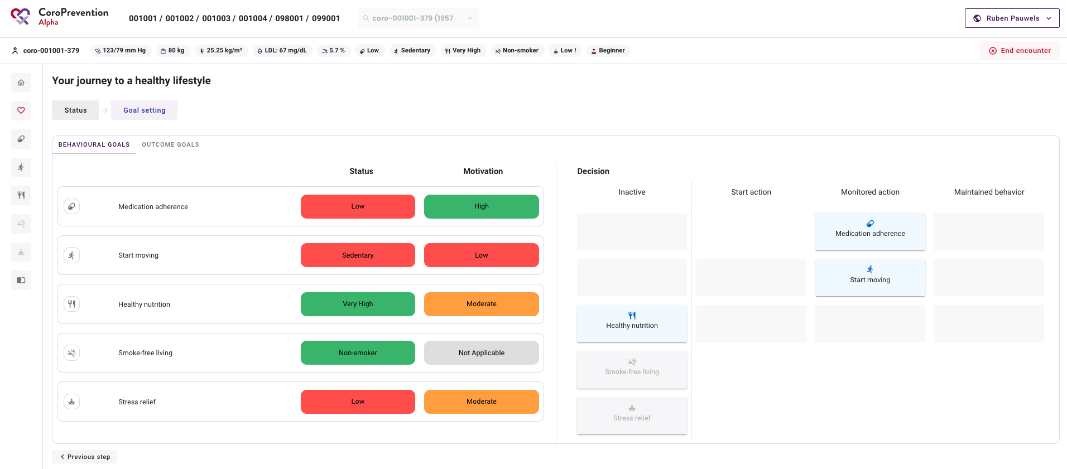

Slide 81
Healthy nutrition

Slide 83
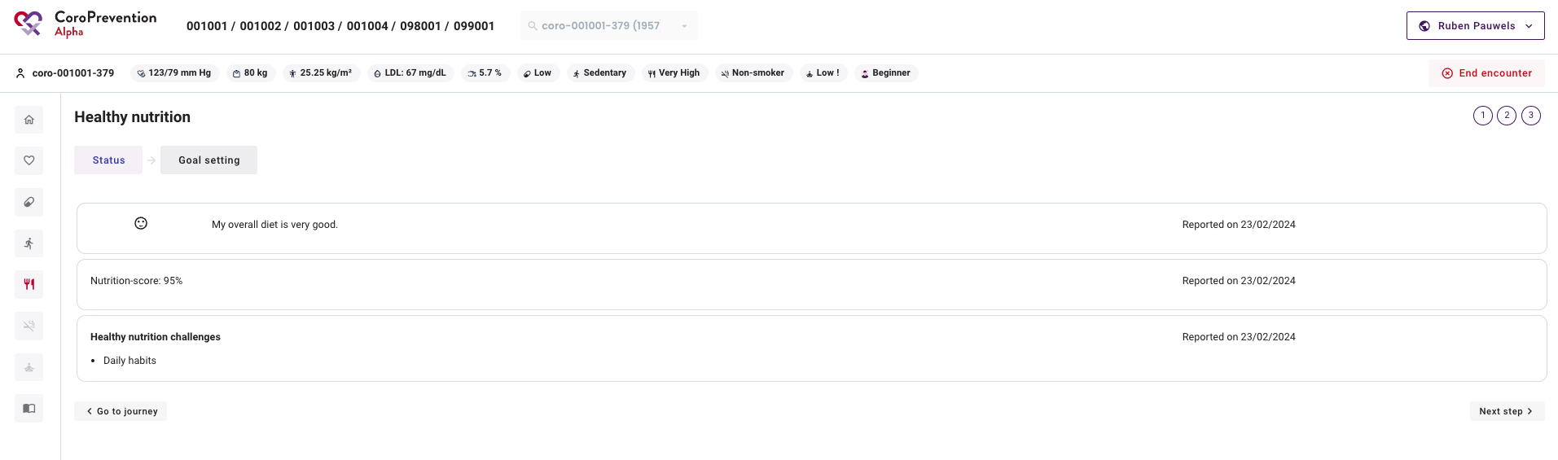

Slide 84
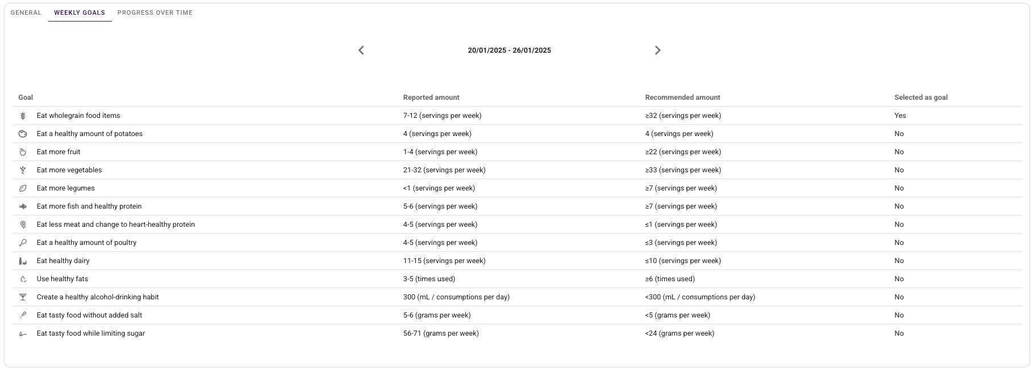

Slide 85


Slide 87


Slide 89



Slide 90
Smoke-free living

Slide 91



Slide 92


Slide 94


Slide 96


Slide 97
Stress relief

Slide 99


Slide 101


Slide 103


Slide 104
Education – Increase your knowledge

Slide 105


Slide 106


Slide 108


Slide 111


Slide 112

At the end of Visit 2
Make sure you save some time for assisting the patient in installing the application on the patient’s smartphone.

Slide 113
End of visit 2 “checklist”
Install the application on the patient’s phone
Print the QR code for the patient to login
Do the “Welcome” reminder together with the patient
Refer to help sources: FAQ, CoroPrevention website and the general user manual
  Patients can request a printed copy if they want.

Slide 114


Good luck!

